Slide 1
STAKEHOLDER MANAGEMENT
PARTNER: IHF asbl
The European Commission's support for the production of this publication does not constitute an endorsement of the contents, which reflect the views only of the authors, and the Commission cannot be held responsible for any use which may be made of the information contained therein.

Slide 2
Objectives and Goals
At the end of this module you will be able to:
identify key stakeholders;
how to assess their power, influence and interest;
how mobilize others with inspiration, persuasion, effective communication and an effective use of the media.
The European Commission's support for the production of this publication does not constitute an endorsement of the contents, which reflect the views only of the authors, and the Commission cannot be held responsible for any use which may be made of the information contained therein.

Slide 3
Unit 1 – Stakeholder Management
Stakeholder management, an introduction
Stakeholder management is the process by which you organize, monitor and improve your relationships with your stakeholders.
It involves systematically identifying stakeholders; analyzing their needs and expectations; and planning and implementing various tasks to engage with them. A good stakeholder management process will be the means through which you are able to coordinate your interactions and asses the status and quality of your relationship with various stakeholders
The European Commission's support for the production of this publication does not constitute an endorsement of the contents, which reflect the views only of the authors, and the Commission cannot be held responsible for any use which may be made of the information contained therein.

Slide 4
Unit 1 – Stakeholder Management
Stakeholders Identification
The project Stakeholders are:
Those who might be impacted by the activities of the project
Those who might have an impact and/or an interest on the activities of the project
I.E.: groups of interest, third sector, public authorities, civil society, investors, academia, competitors and partners, etc.
The European Commission's support for the production of this publication does not constitute an endorsement of the contents, which reflect the views only of the authors, and the Commission cannot be held responsible for any use which may be made of the information contained therein.

Slide 5
Unit 1 – Stakeholder Management
Stakeholders Identification – example
In Young Farmer project
Objective: developing, test and promote innovative learning solutions targeted to young farmers on digital integration and digital entrepreneurship in farming
Target Group: university students, fresh graduates in agronomy or similar,
Stakeholders: those who are interested, affected and can influence
Such as??
The European Commission's support for the production of this publication does not constitute an endorsement of the contents, which reflect the views only of the authors, and the Commission cannot be held responsible for any use which may be made of the information contained therein.

Slide 6
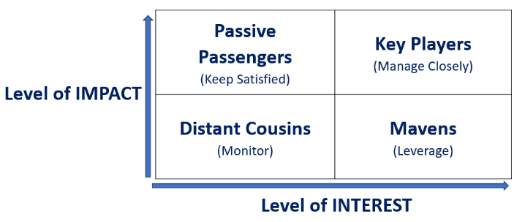
Unit 1 – Stakeholder Management
Stakeholders Identification Tool
The Power/Interest Matrix (Johnson and Scholes, 1999)
Few other sources:
Jeston, J. and Nelis, J. (2008) Business Project Management, Butterworth-Heinemann. pg, 271 - 276.
Dragan Z. Milosevic (2003) Project Management ToolBox: Tools and Techniques for the Practicing Project Manager , John Wiley & Sons, pg. 77.
OGC, Managing Successful Programmes, London: TSO, 2007, pg. 51. Latest edition Managing successful programmes
The European Commission's support for the production of this publication does not constitute an endorsement of the contents, which reflect the views only of the authors, and the Commission cannot be held responsible for any use which may be made of the information contained therein.

Slide 7
Unit 1 – Stakeholder Management
Stakeholders Identification Tool
This tool is both fluid and dynamic:
The European Commission's support for the production of this publication does not constitute an endorsement of the contents, which reflect the views only of the authors, and the Commission cannot be held responsible for any use which may be made of the information contained therein.

Slide 8
Unit 1 – Stakeholder Management
Stakeholders Assessment Tool
After proper identification of the most relevant stakeholders, the below matrix is used to monitor, assess, and evaluate their current level of engagement compared to desired level.
For high priority stakeholders (i.e. Supportive), a situation like in the case of STKH 1 is much more alarming than the case of STKH 3 – being the fact that an overall resistance / disinterest compromises the efforts of the organisation more than what could do a sense of unawareness.
Clearly, the favourable scenario is when D and C match the same box – which means that the engagement strategies are aligning to expectations.
The European Commission's support for the production of this publication does not constitute an endorsement of the contents, which reflect the views only of the authors, and the Commission cannot be held responsible for any use which may be made of the information contained therein.

Slide 9
Unit 1 – Stakeholder Management
Stakeholders Assessment Tool
SK | Unaware | Resistant | Neutral | Supportive | Leading
SK1 | C |  |  |  | D
SK 2 |  |  | C | D
SK 3 |  |  |  | D / C
… | …
SK n
The Stakeholders Engagement Matrix:
Desired (D)/Current (C) engagement
Source: PMBOK® Guide – Sixth Edition (2017)
The European Commission's support for the production of this publication does not constitute an endorsement of the contents, which reflect the views only of the authors, and the Commission cannot be held responsible for any use which may be made of the information contained therein.

Slide 10
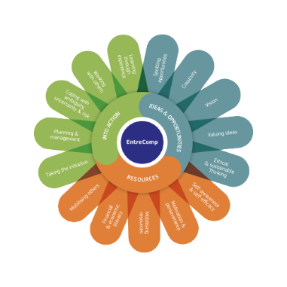
Unit 2 – Mobilizing Others
Mobilizing Others in EntreComp
Mobilizing Others is part of the EntreComp Framework.
This skill has to do with the ability to inspire and motivate relevant stakeholders to get the support needed in achieving valuable outcomes.
One must make sure to demonstrate effective communication, persuasion, negotiation and leadership.
The European Commission's support for the production of this publication does not constitute an endorsement of the contents, which reflect the views only of the authors, and the Commission cannot be held responsible for any use which may be made of the information contained therein.

Slide 11
Unit 2 – Mobilizing Others
How Mobilizing Others?
1. INSPIRE AND GET INSPIRED!
2. PERSUADE!
3. COMMUNICATE EFFECTIVELY!
4. USE MEDIA EFFECTIVELY!
The European Commission's support for the production of this publication does not constitute an endorsement of the contents, which reflect the views only of the authors, and the Commission cannot be held responsible for any use which may be made of the information contained therein.

Slide 12
Unit 2 – Mobilizing Others
Inspire and get Inspired!
Inspiration is key to business success.
Show enthusiasm for challenges and be actively involved in creating value for others!
The European Commission's support for the production of this publication does not constitute an endorsement of the contents, which reflect the views only of the authors, and the Commission cannot be held responsible for any use which may be made of the information contained therein.

Slide 13
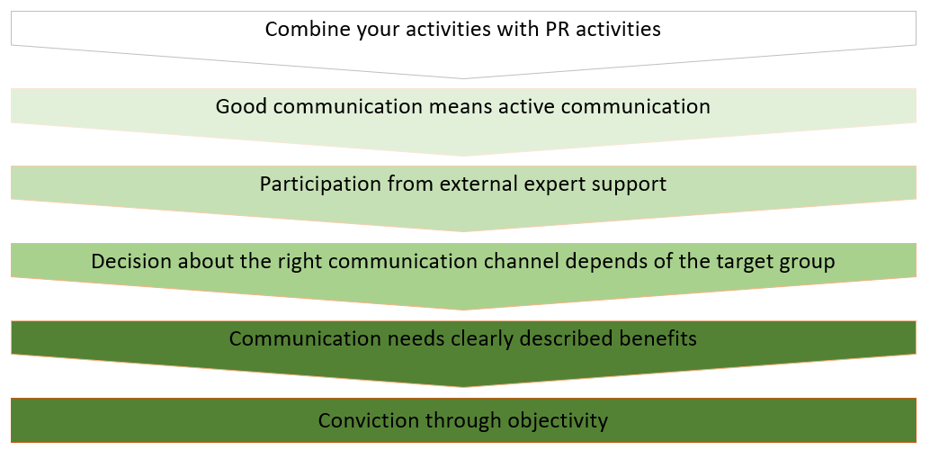
Unit 2 – Mobilizing Others
Inspire and get Inspired!
The European Commission's support for the production of this publication does not constitute an endorsement of the contents, which reflect the views only of the authors, and the Commission cannot be held responsible for any use which may be made of the information contained therein.

Slide 14
Unit 2 – Mobilizing Others
Persuade!
Persuasion is a value creating activity. For instance, in business it consist in selling or trading of a business product, in order to gain profit.
But, what does it mean to persuade and to inspire others in your value-creating activities?
It means to share your idea, in a passionate way, that will inspire others to believe and support your idea as well
The European Commission's support for the production of this publication does not constitute an endorsement of the contents, which reflect the views only of the authors, and the Commission cannot be held responsible for any use which may be made of the information contained therein.

Slide 15
Unit 2 – Mobilizing Others
Effective communication is about more than just exchanging information. It’s about understanding the emotion and intentions behind the information. As well as being able to clearly convey a message, you need to also listen in a way that gains the full meaning of what’s being said and makes the other person feel heard and understood.
Here some tips for an effectively communication:
Become an engaged listener;
Pay attention to nonverbal signals;
Keep stress in check;
Assert yourself.
Communicate effectively!
The European Commission's support for the production of this publication does not constitute an endorsement of the contents, which reflect the views only of the authors, and the Commission cannot be held responsible for any use which may be made of the information contained therein.

Slide 16
Unit 2 – Mobilizing Others
Plan!
Consider your Audienece!
Remember that social media is social.
Dedicate time to social media
Experiment!
Use Media Effectively!
The European Commission's support for the production of this publication does not constitute an endorsement of the contents, which reflect the views only of the authors, and the Commission cannot be held responsible for any use which may be made of the information contained therein.

Slide 17
Natural
Thank You
The European Commission's support for the production of this publication does not constitute an endorsement of the contents, which reflect the views only of the authors, and the Commission cannot be held responsible for any use which may be made of the information contained therein.

