Slide 1


Project Management (PM)
IDP European Consultants
The European Commission's support for the production of this publication does not constitute an endorsement of the contents, which reflect the views only of the authors, and the Commission cannot be held responsible for any use which may be made of the information contained therein.

Slide 2

Objectives and Goals
At the end of this module you will be able to:
identify appropriate agribusiness for formulation;
design feasible and viable projects/business;
propose innovative projects in agricolture filed;
schedule project activities, (sequentially), for effective implementation;
use project resources effectively and efficiently.
The European Commission's support for the production of this publication does not constitute an endorsement of the contents, which reflect the views only of the authors, and the Commission cannot be held responsible for any use which may be made of the information contained therein.

Slide 3
PM
Seeking a definition of PM
Project management is the application of processes, methods, skills, knowledge and experience to achieve specific project objectives according to the project acceptance criteria within agreed parameters. Project management has final deliverables that are constrained to a finite timescale and budget.
A key factor that distinguishes project management from just “management” is that it has this final deliverable and a finite timespan, unlike management which is an ongoing process.
Source: Association for Project Management; APM Body of Knowledge, 7th edition
The European Commission's support for the production of this publication does not constitute an endorsement of the contents, which reflect the views only of the authors, and the Commission cannot be held responsible for any use which may be made of the information contained therein.

Slide 4
PM
What is a project?
A project is temporary; in that it has a defined beginning and end in time, and therefore defined scope and resources.
And a project is unique; in that it is not a routine operation, but a specific set of operations designed to accomplish a singular goal.
Source: Project Management Institute
The European Commission's support for the production of this publication does not constitute an endorsement of the contents, which reflect the views only of the authors, and the Commission cannot be held responsible for any use which may be made of the information contained therein.

Slide 5
PM
Defining elements of PM
Intertwined variables: a change
in one variable will inevitably
affect the others
Resource
Time
Results
The European Commission's support for the production of this publication does not constitute an endorsement of the contents, which reflect the views only of the authors, and the Commission cannot be held responsible for any use which may be made of the information contained therein.

Slide 6
PM
Defining elements of PM
Time (start, sequence of activities, end)
Results (quality and quantity)
Resources (human, material, financial, time…)
Management approach
Team
Stakeholders
The European Commission's support for the production of this publication does not constitute an endorsement of the contents, which reflect the views only of the authors, and the Commission cannot be held responsible for any use which may be made of the information contained therein.

Slide 7
PM
PM as an approach
Why should we bother with Project Management in general?
Why is it relevant in Agriculture?
Caution! Project Management is not an exact science
The European Commission's support for the production of this publication does not constitute an endorsement of the contents, which reflect the views only of the authors, and the Commission cannot be held responsible for any use which may be made of the information contained therein.

Slide 8
PM
Some advantages of PM as an approach (1)
Clear definition of responsibilities
Better use of resources
Improved communication
Achievement of foreseen objectives
Improvement of internal processes
The European Commission's support for the production of this publication does not constitute an endorsement of the contents, which reflect the views only of the authors, and the Commission cannot be held responsible for any use which may be made of the information contained therein.

Slide 9
PM
Some advantages of PM as an approach (2)
PM is a methodology and a “menthality” to introduce discipline in the management of complex and interrelated activities
PM provides a logical framework to work better and implement activities in an ever-changing environment
The European Commission's support for the production of this publication does not constitute an endorsement of the contents, which reflect the views only of the authors, and the Commission cannot be held responsible for any use which may be made of the information contained therein.

Slide 10
PM
The Project Manager
The definition “project manager” is often not associated with any official title within an organisation.
Regardless of internal definitions and/or official titles, the project manager is that person responsible for the implementation
– and completion! – of the project.
An important note is that “responsibility” requires also “authority”: one important feature of a Project Manager refers to Leadership and the ability of managing the project team.
The European Commission's support for the production of this publication does not constitute an endorsement of the contents, which reflect the views only of the authors, and the Commission cannot be held responsible for any use which may be made of the information contained therein.

Slide 11
PM
The Project Manager…by role
The project manager is the person responsible for achieving the stated objectives and is the one ultimately responsible for the overall monitoring of project activities.
A crucial element for the project manager is to define clearly what are the expected results and overall objective of the project, which allows to pinpoint the so called “project requirements”.
The project manager is the person responsible to ensuring that activities are carried out and results achieved within the constraints – or borders – of the project management triangle (resources, time, results).
The European Commission's support for the production of this publication does not constitute an endorsement of the contents, which reflect the views only of the authors, and the Commission cannot be held responsible for any use which may be made of the information contained therein.

Slide 12
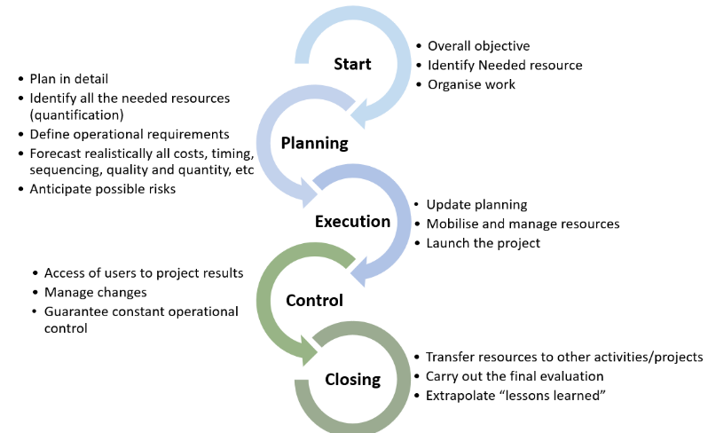
The PM lifecycle
The European Commission's support for the production of this publication does not constitute an endorsement of the contents, which reflect the views only of the authors, and the Commission cannot be held responsible for any use which may be made of the information contained therein.

Slide 13
PM
START
Identify of a specific need or opportunity
Develop a project as the answer to need or opportunity
Define overall objective
Identify needed resources (by type)
Organise work
Draft the Statement Of Work + establish consensus
The European Commission's support for the production of this publication does not constitute an endorsement of the contents, which reflect the views only of the authors, and the Commission cannot be held responsible for any use which may be made of the information contained therein.

Slide 14
PM
2. PLANNING
Plan in detail
Identify all the needed resources (quantification)
Define operational requirements
Forecast realistically all costs, timing, sequencing, quality and quantity, etc
Anticipate possible risks
The European Commission's support for the production of this publication does not constitute an endorsement of the contents, which reflect the views only of the authors, and the Commission cannot be held responsible for any use which may be made of the information contained therein.

Slide 15
PM
3. EXECUTING
Update planning
Mobilise and manage resources
Launch the project
Respond promptly to operational aspects of implementation
The European Commission's support for the production of this publication does not constitute an endorsement of the contents, which reflect the views only of the authors, and the Commission cannot be held responsible for any use which may be made of the information contained therein.

Slide 16
PM
4. CONTROLLING
Access of users to project results
Manage changes
(Re-plan: second round of planning if needed)
Anticipate, identify and resolve conflict resolution / risk management
Guarantee constant operational control
The European Commission's support for the production of this publication does not constitute an endorsement of the contents, which reflect the views only of the authors, and the Commission cannot be held responsible for any use which may be made of the information contained therein.

Slide 17
PM
5. CLOSING
Close the project
Transfer resources to other activities/projects
Carry out the final evaluation
Extrapolate “lessons learned”
The European Commission's support for the production of this publication does not constitute an endorsement of the contents, which reflect the views only of the authors, and the Commission cannot be held responsible for any use which may be made of the information contained therein.

Slide 18
PM For Farmers
Agriculture and PM
Agriculture plays a vital role in economic growth of the country, one of the evergreen field. To sustain the agricultural growth and to save the life of farmers in post-Covid era, it is critical to have a well-equipped project management and skilled project managers.
The European Commission's support for the production of this publication does not constitute an endorsement of the contents, which reflect the views only of the authors, and the Commission cannot be held responsible for any use which may be made of the information contained therein.

Slide 19
PM For Farmers
Key questions
Before start with a new project it is important to clarify the context of the project by answering the following type of questions (Problem analysis):
How can agricultural production be improved?
How can farm incomes be stabilised?
How can added value be generated?
Who are the major stakeholders and beneficiaries?
Who will benefit from the project and who will loose out?
The European Commission's support for the production of this publication does not constitute an endorsement of the contents, which reflect the views only of the authors, and the Commission cannot be held responsible for any use which may be made of the information contained therein.

Slide 20
PM For Farmers
Project Manager in Agriculture
Today for agriculture field project managers need more attention, depth skill of tracking, innovation as well as integrity. We know that agriculture and food are the world’s most important industries. End customers /clients always seeking safety and quality of the products that also in every stages of developments. A project manager can assist for this with farmers and local village bodies.
The European Commission's support for the production of this publication does not constitute an endorsement of the contents, which reflect the views only of the authors, and the Commission cannot be held responsible for any use which may be made of the information contained therein.

Slide 21
PM For Farmers
PM for Farmers
Agricultural business need to put in place a system for effective planning and implementation. For the achievement of poverty reduction strategies, all new projects for agricultural and rural development require identification and planning skills. These projects require the requisite skills for effective implementation to ensure project sustainability.
The European Commission's support for the production of this publication does not constitute an endorsement of the contents, which reflect the views only of the authors, and the Commission cannot be held responsible for any use which may be made of the information contained therein.

Slide 22
PM For Farmers
Step for Project Management for farmers:
prepare a feasibility study;
identify appropriate agribusiness for formulation;
design feasible and viable projects/business;
schedule project activities, (sequentially), for effective implementation;
use project resources effectively and efficiently; and
write appropriate business plan reports;
write a Sustainability monitoring and evaluation plan.
The European Commission's support for the production of this publication does not constitute an endorsement of the contents, which reflect the views only of the authors, and the Commission cannot be held responsible for any use which may be made of the information contained therein.

Slide 23

Natural
Thank You
The European Commission's support for the production of this publication does not constitute an endorsement of the contents, which reflect the views only of the authors, and the Commission cannot be held responsible for any use which may be made of the information contained therein.

