Slide 1


Green management: Sustainable thinking according to the EntreComp Framework
IDP European Consultants
The European Commission's support for the production of this publication does not constitute an endorsement of the contents, which reflect the views only of the authors, and the Commission cannot be held responsible for any use which may be made of the information contained therein.

Slide 2

Objectives and Goals
At the end of this module you will be able to:
- Acquire new knowledges and pratical competences in green management
The aim of the module is to introduce the concept of green management in entrepreneurship in order to guide the young farmer to think sustainable. In this paper, we analyse how farm managers develop responsible management competences and how the competences interact with capabilities at the organisational level.
The European Commission's support for the production of this publication does not constitute an endorsement of the contents, which reflect the views only of the authors, and the Commission cannot be held responsible for any use which may be made of the information contained therein.

Slide 3
Green management
An Introduction
Green Management can be defined as “the management of the interaction and impact of human activities on the natural environment”.
Green management further aims to ensure that ecosystem services and biodiversity are protected and maintained for equitable use by future human generations, and also, maintain ecosystem integrity as an end in itself by taking into consideration ethical, economic, and scientific (ecological) variables.
The European Commission's support for the production of this publication does not constitute an endorsement of the contents, which reflect the views only of the authors, and the Commission cannot be held responsible for any use which may be made of the information contained therein.

Slide 4
Green management
Four aims are determined for adopting green management by businesses:
Organizations should determine and control the effects of their activities to environment.
Organizations should establish environment management system and should include environment politics, programs and aims.
Top manager should contain environment protection and continues development by defining environment politic of the organization.
Organizations should be aware of social responsibilities about environment and should train their personnel as environmentally-conscious.
The European Commission's support for the production of this publication does not constitute an endorsement of the contents, which reflect the views only of the authors, and the Commission cannot be held responsible for any use which may be made of the information contained therein.

Slide 5
Green management
Principle
The aims of green management are to carry out business activities suitable for environment, to protect environment and to provide a perpetual development in aims, visions, targets, business functions, organization structure, functions, production processes, organization culture of the businesses and the businesses should regulate their activities by attaching importance on and fronting preference of technologies used in the business suitable for sustainability principle
The European Commission's support for the production of this publication does not constitute an endorsement of the contents, which reflect the views only of the authors, and the Commission cannot be held responsible for any use which may be made of the information contained therein.

Slide 6
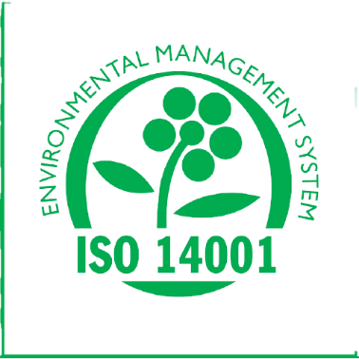
Green management
ISO 14000 environmental management
ISO 14000 is a set of rules and standards created to help companies reduce industrial waste and environmental damage. It's a framework for better environmental impact management, but it's not required. Companies can get ISO 14000 certified, but it's an optional certification;
The European Commission's support for the production of this publication does not constitute an endorsement of the contents, which reflect the views only of the authors, and the Commission cannot be held responsible for any use which may be made of the information contained therein.

Slide 7

Green management
Green management in Agriculture
More and more researchers, activists and agronomists are advocating for a redefinition of the agricultural principles of our society in order to produce a more responsible and resilient farming system.
Agroecology tries to meet this need because it aims to produce a more sustainable and ecological farming system.
The agro-ecology is to be studied as an integral part of the system of farm management (along with the management of production, laour, finance, innovation, inputs supply, marketing) and the system of eco-management in the society.
The European Commission's support for the production of this publication does not constitute an endorsement of the contents, which reflect the views only of the authors, and the Commission cannot be held responsible for any use which may be made of the information contained therein.

Slide 8
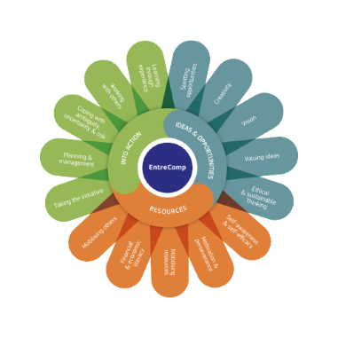
Sustainable Thinking
EntreComp, an introduction
The European Commission has developed EntreComp: the European Entrepreneurship Competence Framework as a reference framework to explain what is meant by an entrepreneurial mindset.
EntreComp offers a comprehensive description of the knowledge, skills and attitudes that people need to be entrepreneurial and create financial, cultural or social value for others.
EntreComp is a common reference framework that identifies 15 competences in three key areas that describe what it means to be entrepreneurial.
The European Commission's support for the production of this publication does not constitute an endorsement of the contents, which reflect the views only of the authors, and the Commission cannot be held responsible for any use which may be made of the information contained therein.

Slide 9
Sustainable Thinking
Ethical and sustainable thinking
In the area called “Ideas and opportunities” one strategic of the competences listed is “Ethical and Sustainable thinking”. To be able to think ethical and sustainable means to assess the consequences and impact of ideas, opportunities and actions.
Ethical and sustainable thinking is a matter of the attitudes, behaviours, values and mindset that an entrepreneur should have to take ethical decisions and act sustainably
The European Commission's support for the production of this publication does not constitute an endorsement of the contents, which reflect the views only of the authors, and the Commission cannot be held responsible for any use which may be made of the information contained therein.

Slide 10

Sustainable Thinking
Think sustainably: a definition
Sustainability is the avoidance of the depletion of natural resources in order to maintain an ecological balance.
Think sustainably means reflecting on how sustainable long-term social, cultural and economic goals are and what approach should be taken to achieve the greatest possible sustainability.
The European Commission's support for the production of this publication does not constitute an endorsement of the contents, which reflect the views only of the authors, and the Commission cannot be held responsible for any use which may be made of the information contained therein.

Slide 11
Sustainable Thinking
Think sustainably: why it matters?
Climate change, the destruction of biodiversity, the hole in the ozone layer, overfishing of the oceans are just some of the consequences of human activity that must be countered by sustainable thinking and development. Therefore, sustainable development is probably the most important issue for civil society in the 21st century.
Acting in accordance with the principle of sustainability aims to use resources in such a way that the environment can regenerate itself as naturally as possible and the world society is shaped in a way that is worth living
Source: Grünberg-Bochard J., Schaltegger S. (2014) Zukunftsstrategie Nachhaltiges Unternehmertum. In: von Müller C., Zinth CP. (eds) Managementperspektiven für die Zivilgesellschaft des 21. Jahrhunderts. Springer Gabler, Wiesbaden. https://doi.org/10.1007/978-3-658-02523-6_8, access: 30.10.2020
The European Commission's support for the production of this publication does not constitute an endorsement of the contents, which reflect the views only of the authors, and the Commission cannot be held responsible for any use which may be made of the information contained therein.

Slide 12
Sustainable Thinking
Sustainability as a guideline
Similar as an ethical decision making, sustainability-oriented entrepreneurs assess the consequences of ideas that bring value and the effect of entrepreneurial action on the target community, the market, society and especially the environment
ecology
social affairs
economy
To think sustainable means to consider …
The European Commission's support for the production of this publication does not constitute an endorsement of the contents, which reflect the views only of the authors, and the Commission cannot be held responsible for any use which may be made of the information contained therein.

Slide 13
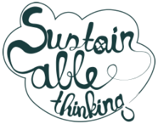
Sustainable Thinking
Benefits
When a company integrates sustainability into their strategic plan, they are gaining a better understanding of what lies ahead. Thinking into the foreseeable future and exploring how they might satisfy production needs five years down the road encourages planners to think about alternatives to ensure that their operations are built to last.
The European Commission's support for the production of this publication does not constitute an endorsement of the contents, which reflect the views only of the authors, and the Commission cannot be held responsible for any use which may be made of the information contained therein.

Slide 14
Sustainable Thinking
Benefits
Becoming sustainable means a reduction in energy usage;
More efficiency often means less waste…
…which means less pollution;
Sustainable practices usually mean an overall reduction of operating costs;
Sustainability almost always means new markets;
Sustainable businesses attract better quality investments;
Earn some local cred;
Sustainability can, and will, factor heavily into buying decisions in the future.
Source: Resource management Associate
The European Commission's support for the production of this publication does not constitute an endorsement of the contents, which reflect the views only of the authors, and the Commission cannot be held responsible for any use which may be made of the information contained therein.

Slide 15

Natural
Thank You
The European Commission's support for the production of this publication does not constitute an endorsement of the contents, which reflect the views only of the authors, and the Commission cannot be held responsible for any use which may be made of the information contained therein.

