Slide 1
ὀψίζω Suite
DEI tool for micro-enterprises for
inclusive communication
Author partner: Internet Web Solutions
Diversity & Inclusion in Microenterprise
2022-1-IT01-KA220-VET-000088750
https://opsizo.eu/index.php
The European Commission's support for the production of this publication does not constitute an endorsement of the contents, which reflect the views only of the authors, and the Commission cannot be held responsible for any use which may be made of the information contained therein.
Legal description – Creative Commons licensing: The materials published on the Opsizo project website are classified as Open Educational Resources' (OER) and can be freely (without permission of their creators): downloaded, used, reused, copied, adapted, and shared by users, with information about the source of their origin.

Slide 2
Objectives and Goals
At the end of this module, you will be able to:
01 Recognize stereotypical images
02 Make sure that that the images you choose to use in communication
materials do not reinforce gender stereotypes.
03 Choose gender-neutral colours, images, in a company website/corporative image implementation
04 Spot biased emails
The European Commission's support for the production of this publication does not constitute an endorsement of the contents, which reflect the views only of the authors, and the Commission cannot be held responsible for any use which may be made of the information contained therein.

Slide 3
Unit 1
How images can change the world
The contents are inspired by the “ Images that can change the world” – A guide to equal communication by Tomas Gunnarsson, ‘The Gender Photographer’
https://www.genusfotografen.se/language/en/home-2/
The European Commission's support for the production of this publication does not constitute an endorsement of the contents, which reflect the views only of the authors, and the Commission cannot be held responsible for any use which may be made of the information contained therein.

Slide 4
Unit 1
How images can change the world
Choosing gender-neutral colors and images for your corporate website is an important step in promoting inclusivity and diversity. Here are some guidelines to consider:
Color accessibility – Web Design
In the context of web design and digital content, there is an emphasis on color accessibility. Using color combinations that provide sufficient contrast is important to ensure that people with visual impairments can access and understand the content. Colors can carry cultural, symbolic, or emotional meanings that can impact how they are used and perceived. For example, some colors may be associated with certain cultural or religious practices. The use of certain colors in certain contexts might be considered offensive or insensitive, leading to potential legal and reputational consequences.
The European Commission's support for the production of this publication does not constitute an endorsement of the contents, which reflect the views only of the authors, and the Commission cannot be held responsible for any use which may be made of the information contained therein.

Slide 5
Unit 1
How images can change the world
Color accessibility – Web Design
The colour red evokes dynamism.
The colour orange expresses energy, friendship, optimism and action.
The colour yellow expresses energy, warmth, joy, stimulus to action andinvolvement .... however it is hardly visible on a white background!
The colour green: stability and renewal, nature.
The colour blue: is associated with a sense of trust, security, of tranquillity
The colour black: par excellence represents power.
The colour grey: neutrality.
The European Commission's support for the production of this publication does not constitute an endorsement of the contents, which reflect the views only of the authors, and the Commission cannot be held responsible for any use which may be made of the information contained therein.

Slide 6
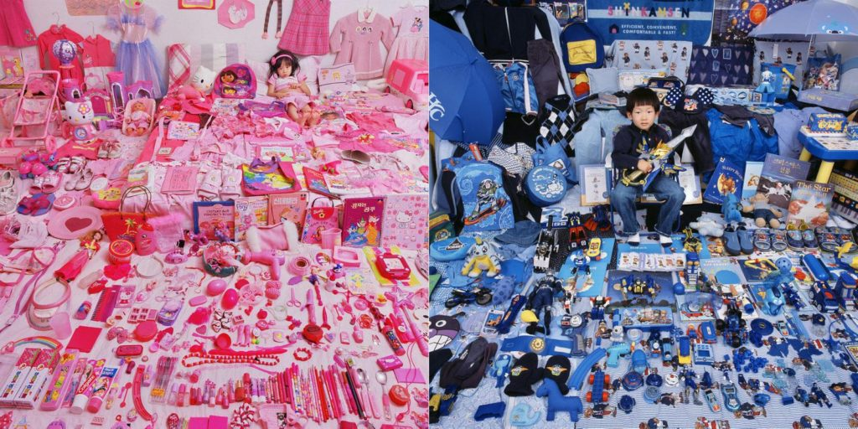
Unit 1
How images can change the world
Avoid using stereotypical colors
Colours are often arbitrarily connected to one gender, such as pink for women and blue for men. When designing communication materials, check the colours you have used and don’t use colour as a shorthand for gender.
The European Commission's support for the production of this publication does not constitute an endorsement of the contents, which reflect the views only of the authors, and the Commission cannot be held responsible for any use which may be made of the information contained therein.

Slide 7
Unit 1
How images can change the world
2. Images– Web Design
When done right, images can include and mirror all people, not just those who fit into the norm in society. And images can tickle our imagination when it comes to what we can do with our lives, and who we can become.
Let’s analyse the Opsizo home page picture in the OER Platform
Different skin-tone colours, race, gender,
In a workplace regardless of whom you love, what colour your skin is, what god you believe in, how your body or brain works, what genitals you have, whether you’re old or young – you deserve to be
seen, heard and respected.
The European Commission's support for the production of this publication does not constitute an endorsement of the contents, which reflect the views only of the authors, and the Commission cannot be held responsible for any use which may be made of the information contained therein.

Slide 8
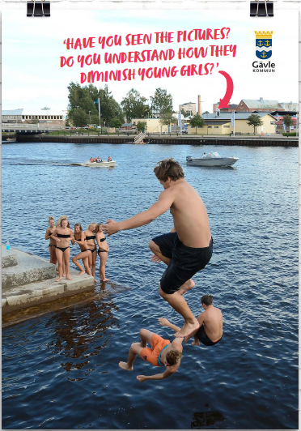
Unit 1
How images can change the world
2. A world where men do and women watch
Analyse the photo and have a look at who is passive, watching, admiring and who is active, brave and showing off
Girls watching
A group of boys are throwing themselves into the water of Gävle Harbour (Sweden)
The European Commission's support for the production of this publication does not constitute an endorsement of the contents, which reflect the views only of the authors, and the Commission cannot be held responsible for any use which may be made of the information contained therein.

Slide 9
Unit 1
How images can change the world
3. Images affect how we see each other
When you belong to those who fit into the norm in society, you can without any difficulty look around and find people that look like you – in movies, talk shows, newspapers and furniture catalogues. You might not even be aware that for some people, the media is not a mirror.
Images – or the absence of images – affect how we see each other, and ourselves. When some people are invisible in the media, when their voices and stories are never heard, there is a void left to be filled with prejudice and stereotypes.
The European Commission's support for the production of this publication does not constitute an endorsement of the contents, which reflect the views only of the authors, and the Commission cannot be held responsible for any use which may be made of the information contained therein.

Slide 10
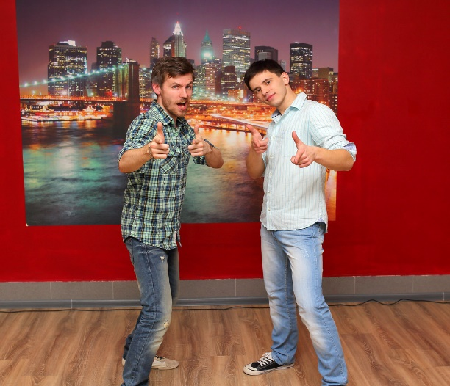
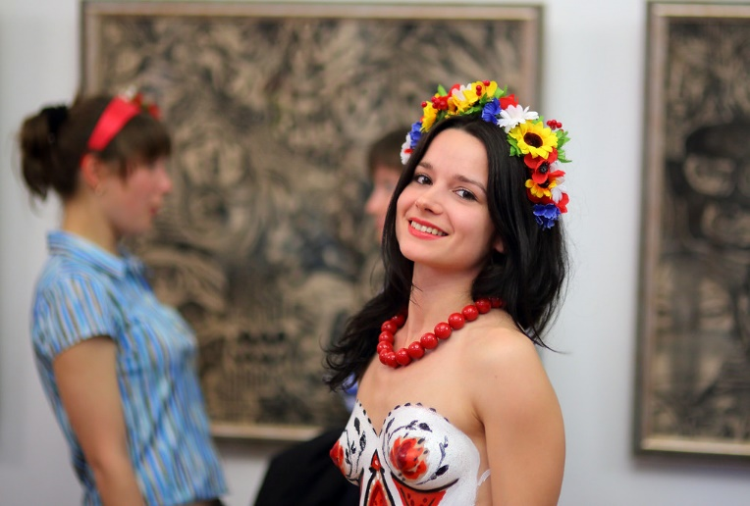
Unit 1
How images can change the world
4. General norms in photographs
Tomas Gunnarsson, ‘The Gender Photographer’ reflects on how
[…] “Men are often photographed from below; a camera angle that makes them look bigger, more important, superior (to you, since the viewer ‘looks up’ at the person). | For women, the cliché is the opposite – they are photographed from above; an angle that makes them look smaller, cuter and less threatening. for women, there’s a special rule you have to follow whenever you have your picture taken: smile.
"Men" by be creator is licensed under CC BY 2.0.
"One night in museam" by be creator is licensed under CC BY 2.0.
The European Commission's support for the production of this publication does not constitute an endorsement of the contents, which reflect the views only of the authors, and the Commission cannot be held responsible for any use which may be made of the information contained therein.

Slide 11
Unit 1
How images can change the world
4. General norms in photographs
Tomas Gunnarsson, ‘The Gender Photographer’ reflects on how
As a woman, you’re supposed to look friendly, accessible and angelic, radiating warmth. This cements the norm that a woman’s role is to please. It also
causes women not smiling – who might be focusing on something important,
or have a ‘resting bitch face’ when their face muscles are relaxed
– to be interpreted as angry or hostile.
Men with the exact same expression,
on the other hand, are interpreted as serious and determined.
The solution is simple: just let the context, rather than a person’s
gender, decide if they look happy or not.
QUICK
TIPS
The European Commission's support for the production of this publication does not constitute an endorsement of the contents, which reflect the views only of the authors, and the Commission cannot be held responsible for any use which may be made of the information contained therein.

Slide 12
Unit 1
How images can change the world
Compare the two photos.
Can you make a simple gender analysis and spot any differences?
The European Commission's support for the production of this publication does not constitute an endorsement of the contents, which reflect the views only of the authors, and the Commission cannot be held responsible for any use which may be made of the information contained therein.

Slide 13
Unit 1
How images can change the world
Some reflections
Both mommy and daddy are active, on the same line, playing with kids
Mom and daughter sitting and admiring/ daddy and son active, playing
The European Commission's support for the production of this publication does not constitute an endorsement of the contents, which reflect the views only of the authors, and the Commission cannot be held responsible for any use which may be made of the information contained therein.

Slide 14
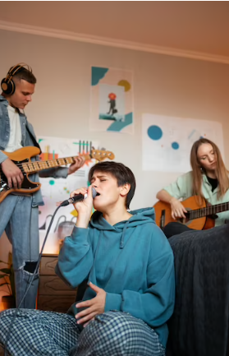
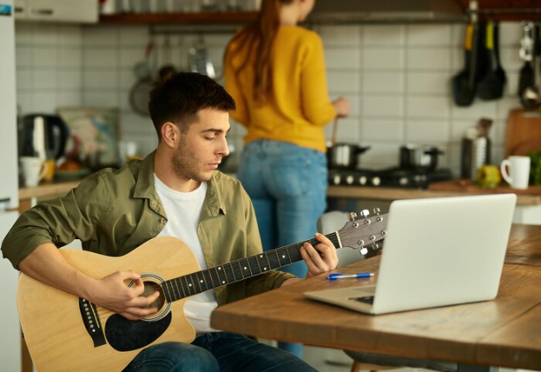
Unit 1
Section Title
Compare the two photos.
Can you make a simple gender analysis and spot any differences?
The European Commission's support for the production of this publication does not constitute an endorsement of the contents, which reflect the views only of the authors, and the Commission cannot be held responsible for any use which may be made of the information contained therein.

Slide 15
Unit 1
How images can change the world
Some reflections
A boy jamming
A girl cooking
Boy and girls jamming and singing
The European Commission's support for the production of this publication does not constitute an endorsement of the contents, which reflect the views only of the authors, and the Commission cannot be held responsible for any use which may be made of the information contained therein.

Slide 16
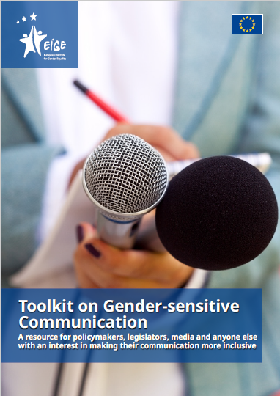
Unit 2
How to spot biased email
The contents are inspired by the “Toolkit on Gender-sensitive Communication
- A resource for policymakers, legislators, media and anyone else with an interest in making their communication more inclusive”
(The European Institute for Gender Equality)
The European Commission's support for the production of this publication does not constitute an endorsement of the contents, which reflect the views only of the authors, and the Commission cannot be held responsible for any use which may be made of the information contained therein.

Slide 17
Unit 2
How to spot biased email
2.1 Use of ‘he’ to refer to unknown people
Gendered nouns and adjectives used to denote generic experiences encourage us to view the world as mainly having relevance to men. The word ‘manmade’ equates the word ‘man’ with ‘human’. The term ‘postman’ suggests all postal workers are men. In a gender-equal society it is important to use language that recognises that these posts can be held by women or men.
Gendered nouns and adjectives should be avoided and replaced with gender-neutral terms. Gender-discriminatory language Better language
Gender-discriminatory language | Better language
Man in the street | Average person
Every man for himself | Everyone for themselves
Mankind | Humankind
To a man | Every person
The European Commission's support for the production of this publication does not constitute an endorsement of the contents, which reflect the views only of the authors, and the Commission cannot be held responsible for any use which may be made of the information contained therein.

Slide 18
Unit 2
How to spot biased email
2.1 Common adjectives that carry a gender connotation and alternativelanguage
Gendered adjectives | Alternatives
Bossy or pushy | Assertive
Emotional or hormonal | Passionate, enthusiastic, empathetic
Frigid (no male equivalent) | Lacking sexual responsiveness
Loose (no male equivalent) | Having sexual confidence
The European Commission's support for the production of this publication does not constitute an endorsement of the contents, which reflect the views only of the authors, and the Commission cannot be held responsible for any use which may be made of the information contained therein.

Slide 19
Unit 2
How to spot biased email
2.1 Common expression that carry a gender connotation and alternativelanguage
Gendered expression | Alternatives
Master of ceremonies | Host
Best man for the job | Best candidate for the job/ Best woman-men for the job
Man-hour | Staffhour
Mastermind | Creator
The European Commission's support for the production of this publication does not constitute an endorsement of the contents, which reflect the views only of the authors, and the Commission cannot be held responsible for any use which may be made of the information contained therein.

Slide 20
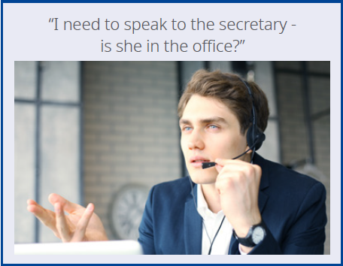
Unit 2
How to spot biased email
Professions and occupations are often gender stereotyped. Take special care to avoid stereotypes when talking about people’s occupations.
“I need to speak to the secretary- is she in the office?
QUICK
TIPS
Professions and occupations are often gender stereotyped. Take special care to avoid stereotypes when talking about people’s occupations.
The European Commission's support for the production of this publication does not constitute an endorsement of the contents, which reflect the views only of the authors, and the Commission cannot be held responsible for any use which may be made of the information contained therein.

Slide 21
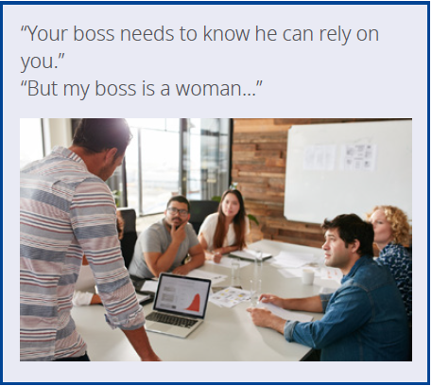
Unit 2
How to spot biased email
QUICK
TIPS
Do not rely on “he/him/man” when talking about an individual in the abstract – this excludes women from the conversation.
The European Commission's support for the production of this publication does not constitute an endorsement of the contents, which reflect the views only of the authors, and the Commission cannot be held responsible for any use which may be made of the information contained therein.

Slide 22
Unit 2
How to spot biased email
Read some extract from emails. Extract 1
How many instances of gender-discriminatory language did you count?
Hints: Naming conventions, titles and how to refer to people/ Word or phrase hierarchy/ Diminutive affixes/ Terms for women
Extract 1:
Every person has the right to choose his employer and to enter into work of his
own volition, assuming he fulfils the necessary qualification criteria and is deemed suitable for the work by the employer in question. The government shall not interfere with this right, except in cases when the individual in question
The European Commission's support for the production of this publication does not constitute an endorsement of the contents, which reflect the views only of the authors, and the Commission cannot be held responsible for any use which may be made of the information contained therein.

Slide 23
Unit 2
How to spot biased email
Read some extract from emails. Extract 2
How many instances of gender-discriminatory language did you count?
Hints: Naming conventions, titles and how to refer to people/ Word or phrase hierarchy/ Diminutive affixes/ Terms for women
Extract 2:
Each candidate must submit her application by Monday 12 December at 12.00. For more information, see the full Application.
The European Commission's support for the production of this publication does not constitute an endorsement of the contents, which reflect the views only of the authors, and the Commission cannot be held responsible for any use which may be made of the information contained therein.

Slide 24
Continue your training path at: https://opsizo.eu/index.php
The European Commission's support for the production of this publication does not constitute an endorsement of the contents, which reflect the views only of the authors, and the Commission cannot be held responsible for any use which may be made of the information contained therein.
Legal description – Creative Commons licensing: The materials published on the Opsizo project website are classified as Open Educational Resources' (OER) and can be freely (without permission of their creators): downloaded, used, reused, copied, adapted, and shared by users, with information about the source of their origin.

