Slide 1
ὀψίζω Suite
DEI tool for micro-enterprises for
Gender self-empowerment
Author partner: IHK-Projektgesellschaft (Germany)
Diversity & Inclusion in Microenterprise
2022-1-IT01-KA220-VET-000088750
https://opsizo.eu/index.php
The European Commission's support for the production of this publication does not constitute an endorsement of the contents, which reflect the views only of the authors, and the Commission cannot be held responsible for any use which may be made of the information contained therein.
Legal description – Creative Commons licensing: The materials published on the Opsizo project website are classified as Open Educational Resources' (OER) and can be freely (without permission of their creators): downloaded, used, reused, copied, adapted, and shared by users, with information about the source of their origin.

Slide 2
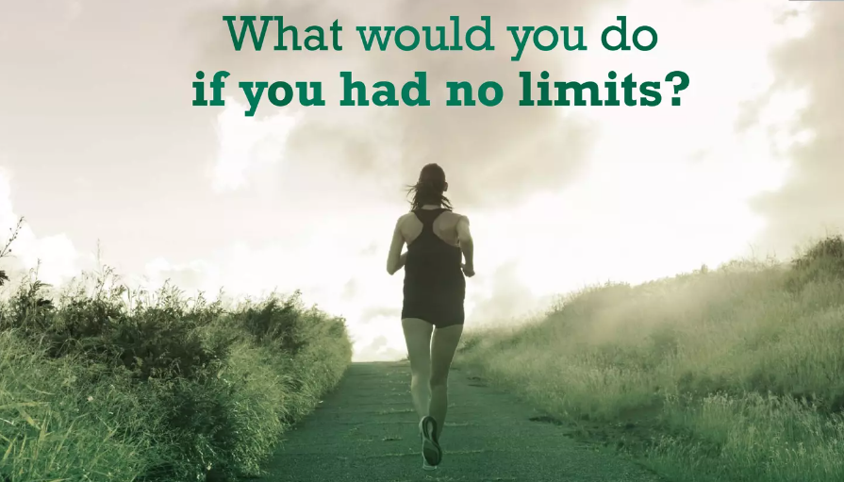
Gender self-empowerment involves taking control of one's own identity, expression, and rights within the context of gender.
While the journey is deeply personal and unique to each individual, there are tools and best practices that can be helpful.
It's important to note that these suggestions may not be universally applicable, and individuals should choose what works best for them.
The European Commission's support for the production of this publication does not constitute an endorsement of the contents, which reflect the views only of the authors, and the Commission cannot be held responsible for any use which may be made of the information contained therein.

Slide 3
Here are some tools and best practices for gender self-empowerment:
The European Commission's support for the production of this publication does not constitute an endorsement of the contents, which reflect the views only of the authors, and the Commission cannot be held responsible for any use which may be made of the information contained therein.

Slide 4
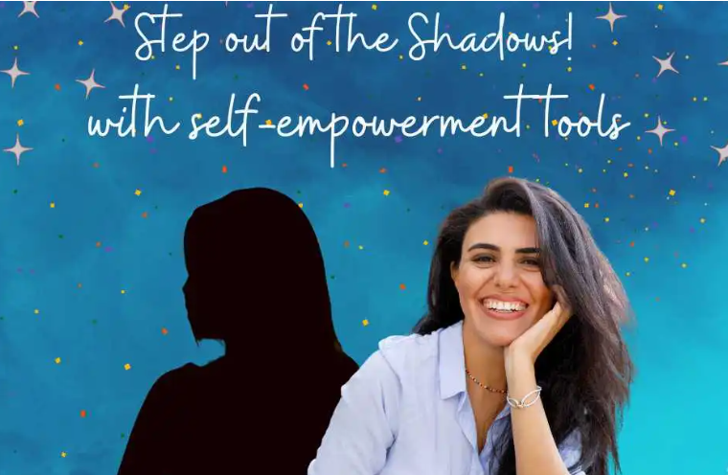
1. Education and Awareness:
Read and Research: Educate yourself about gender identity, expression, and the experiences of others. Knowledge is a powerful tool in understanding and affirming your own identity.
Stay Informed: Keep up with news, developments, and discussions related to gender issues. This can help you stay connected to broader conversations and movements.
2. Legal Resources:
Understand Your Rights: Familiarize yourself with local and national laws protecting gender identity and expression. Knowing your rights can empower you in various aspects of life.
The European Commission's support for the production of this publication does not constitute an endorsement of the contents, which reflect the views only of the authors, and the Commission cannot be held responsible for any use which may be made of the information contained therein.

Slide 5
3. Community Support:
Join Supportive Communities: Connect with others who share similar experiences. Online forums, social media groups, and local support groups can provide valuable insights, advice, and a sense of community.
Attend Events: Participate in events, workshops, or conferences that focus on gender diversity and empowerment. These gatherings can be both informative and empowering.
4. Build a Support Network:
Surround Yourself with Supportive People: Foster relationships with friends, family, and allies who respect and support your gender identity. Having a strong support network can make a significant difference.
https://de.freepik.com/fotos-kostenlos/mittelgrosse-freunde-die-zusammen-feiern_17642343.htm#page=3&query=events&position=34&from_view=search&track=sph&uuid=19a4d02a-95c1-4de3-b51f-c8cdd073664c
The European Commission's support for the production of this publication does not constitute an endorsement of the contents, which reflect the views only of the authors, and the Commission cannot be held responsible for any use which may be made of the information contained therein.

Slide 6
5. Self-Expression:
Express Yourself Authentically:
Explore different aspects of your gender identity through clothing, hairstyle, makeup, or other means of self-expression. Experimenting with your appearance can be a powerful way to affirm your identity.
6. Mindfulness and Self-Care:
Practice Self-Compassion:
Gender self-empowerment can be a challenging journey. Practicing self-compassion and self-care is crucial for maintaining mental and emotional well-being.
https://de.freepik.com/fotos-kostenlos/junge-maedchen-die-spass-in-der-teenagerparty-haben_11624280.htm#page=4&query=Gender%20style&position=14&from_view=search&track=ais&uuid=85ff0a21-6f03-4157-88aa-69c6aedaa28e
The European Commission's support for the production of this publication does not constitute an endorsement of the contents, which reflect the views only of the authors, and the Commission cannot be held responsible for any use which may be made of the information contained therein.

Slide 7
7. Documentation and Journaling:
Keep a Journal: Documenting your thoughts, feelings, and experiences in a journal can help you track your journey, celebrate milestones, and reflect on your growth.
8. Professional Development:
Invest in Your Skills: Empowerment extends beyond personal identity. Invest in your education and skills to achieve your professional goals, contributing to your overall sense of self-empowerment.
https://de.freepik.com/fotos-kostenlos/entwicklungs-wachstums-fortschritts-ikonen-konzept_2758711.htm#query=Professional%20Development&position=0&from_view=search&track=ais&uuid=782a4fce-0b48-43a8-9f84-be3c26c7a32f
The European Commission's support for the production of this publication does not constitute an endorsement of the contents, which reflect the views only of the authors, and the Commission cannot be held responsible for any use which may be made of the information contained therein.

Slide 8
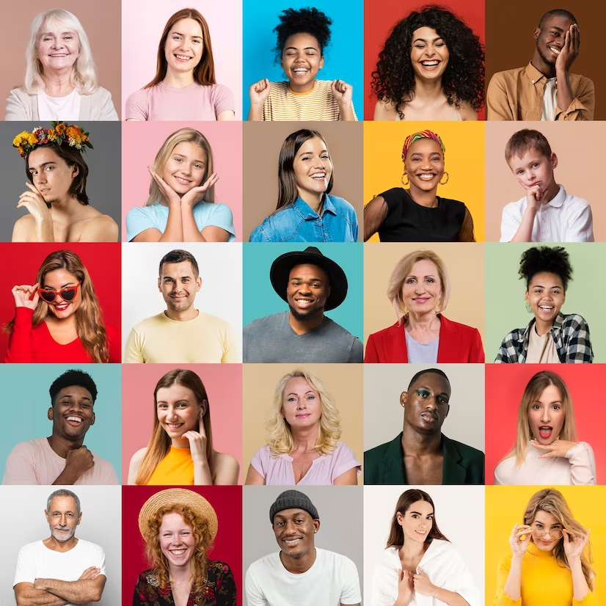
Remember, the journey of gender self-empowerment is unique to each person.
It's important to be patient with yourself and to seek out the resources and practices that resonate with your individual experience.
The European Commission's support for the production of this publication does not constitute an endorsement of the contents, which reflect the views only of the authors, and the Commission cannot be held responsible for any use which may be made of the information contained therein.

Slide 9
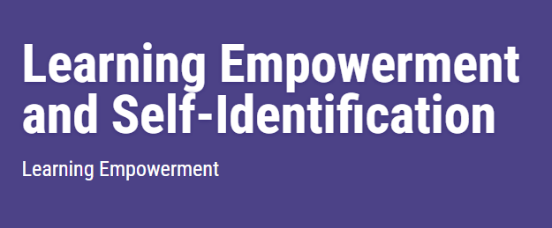
Training Unit:
Participants will learn the power of self-identified labels and identities they would like to be called.
Participants will discuss the impact of labels, and the idea of consent as applied to labels. Participants will generate examples of positive labels.
https://www.glsen.org/activity/learning-empowerment-and-self-identification
The European Commission's support for the production of this publication does not constitute an endorsement of the contents, which reflect the views only of the authors, and the Commission cannot be held responsible for any use which may be made of the information contained therein.

Slide 10
Training Unit:
https://www.glsen.org/activity/learning-empowerment-and-self-identification
THINGS TO PREP & TOOLS NEEDED
Slurs and Stereotypes video, Copies of the Example Case Studies, GLSEN’s I Am Signage handout, computers, speakers, Internet access, projector, screen, markers, paper, pencils.
The European Commission's support for the production of this publication does not constitute an endorsement of the contents, which reflect the views only of the authors, and the Commission cannot be held responsible for any use which may be made of the information contained therein.

Slide 11
Training Unit:
TIME
60 minutes.
ALL ABOUT THE ACTIVITY
1. Introduction and Opening Question: (10 minutes) Welcome members and explain to everyone that today we will focus on talking about the impact of labels. Then ask them the opening question, “What are labels?”
Example: “Hello, everyone. Today we’re going to learn about labels. First, what are labels?
Once a few participants share their definitions. “Labels are things other folks call us. Labels can be identities and adjectives. When folks use labels on us, they can be empowering or hurtful. Self-identification helps us claim what labels we want folks to use with us.
Respecting people’s self-identified labels can build bonds and friendships. Labels used in harmful ways, such as using stereotypes and reinforcing that by calling someone a derogatory label.
Stereotypes are based off of assumptions, or generalizations about someone based off of the labels you think they hold. Name calling is when someone uses words to invoke harm or make someone feel bad about themselves. To avoid stereotyping or name calling folks should check in with a person if they want any label used with them before using it.
This activity will discuss how we can work towards calling people what they would like to be called.”
The European Commission's support for the production of this publication does not constitute an endorsement of the contents, which reflect the views only of the authors, and the Commission cannot be held responsible for any use which may be made of the information contained therein.

Slide 12
Training Unit:
2. (5 minutes) Opening: Show the video, “Slurs and Stereotypes”.
3. (10 minutes) Lead the group in discussion about the video by asking some of these questions. To save on time have only 1-3 people answer each question:
What were examples of labels that you saw in the video?
What do you think the impact of the different labels that were put on the students versus what they chose for themselves?
How have you seen the impact of labels in this school?
How does it feel when you are not allowed to identify with labels that you would like to be called?
How does it feel when people use the labels that you do identify with?
What’s happened when you’ve seen someone use a label they don’t identify with or want to be called?
What is the difference between a self-identified label and a stereotype?
The European Commission's support for the production of this publication does not constitute an endorsement of the contents, which reflect the views only of the authors, and the Commission cannot be held responsible for any use which may be made of the information contained therein.

Slide 13
Training Unit:
(20 min) Case Studies:
Break the group up into smaller groups. The group size can be customizable to the number of students that you have that day, however there are five case studies.
Distribute copies of the case studies. Tell each group to read the example and work together to answer the questions.
Display the questions on the board for their reference. Groups will have 10 minutes to work on answering the questions, then there will be a whole-group report back.
Discussion Questions:
How did the person self-identify in your story?
In your example, how did the use of labels might have impacted the person in your story?
How did the person’s peers around them validate their identity?
How is the use of self-identifying labels empowering for the main person in your story?
What did consent look/sound like in your story? How did consent matter in the story?
Whole-group Discussion: Ask each group to share the answer to one of their questions.
What were highlights from your group discussions?
The European Commission's support for the production of this publication does not constitute an endorsement of the contents, which reflect the views only of the authors, and the Commission cannot be held responsible for any use which may be made of the information contained therein.

Slide 14
Training Unit:
4. (10 minutes) Pass out GLSEN’s “I Am” signage handout to the participants. Remind participants that they are in charge of the labels that feel good to them, that labels should not be enforced by stereotypes or used without their permission. Ask participants to fill in the signs with identifiers, adjectives, or other words that feel good to them and that can tell others about who they are.
Let students know these signs will be posted up on a bulletin board.
Ask a few participants to share their signs or to name some of the labels they have chosen with the group. Collect the signs to create a bulletin board collage in the classroom.
5. (5 minutes) Closing Reflection.
Note: The closing reflection and extension questions can also be assigned as a follow-up or homework assignment.
Tell the participants, “Today we talked about labels and names that people want to be called. It’s empowering to be in control and claim what labels feel right to you, which is why it can be so hurtful when people use labels one doesn’t identify with without their consent.”
Extension Reflection Questions:
What are steps you can take to make sure that the people around you, your friends and classmates, are being called what they want to be called?
What could you do if you notice someone is being called a label that doesn’t feel good to them?
What should you do if you use a label for someone without their consent?”
The European Commission's support for the production of this publication does not constitute an endorsement of the contents, which reflect the views only of the authors, and the Commission cannot be held responsible for any use which may be made of the information contained therein.

Slide 15
Training Unit:
TERMS TO KNOW
CASE STUDIES
The European Commission's support for the production of this publication does not constitute an endorsement of the contents, which reflect the views only of the authors, and the Commission cannot be held responsible for any use which may be made of the information contained therein.

Slide 16
Continue your training path at: https://opsizo.eu/index.php
The European Commission's support for the production of this publication does not constitute an endorsement of the contents, which reflect the views only of the authors, and the Commission cannot be held responsible for any use which may be made of the information contained therein.
Legal description – Creative Commons licensing: The materials published on the Opsizo project website are classified as Open Educational Resources' (OER) and can be freely (without permission of their creators): downloaded, used, reused, copied, adapted, and shared by users, with information about the source of their origin.

