Slide 1
Module No 1: Marketing/Promotion & E-commerce
MICRO: Enhancing Competitiveness of Micro-enterprises in Rural Areas
Prepared by the Consortium for the project: “Irish Rural Link – National University of Ireland Maynooth- CDI – EEO GROUP SA- IHF asbl – IDP - Internet Web Solutions SL”

Slide 2
E-Commerce
Overview
How many slides? | 18 slides in total
How long to read and listen? | 15 minutes (not including exploring the links provided within slides)
What is the benefit? | See aim and expected learning in following slides

Slide 3
E-Commerce
Unit Aim
The Unit provides an Introduction to E-commerce and types of e-commerce, as well as the business opportunities in e-commerce

Slide 4
E-Commerce
Expected Learning Outcomes
At the end of this module you will be able to:
To learn:
the definitions of e-commerce, Electronic Data Interchange, Electronic Funds Transfer.
The types of e-commerce.
The new business opportunity in e-commerce

Slide 5
What is e-commerce?
E-Commerce
E-commerce consists of buying and selling of products or services using electronic systems such as the Internet and other computer networks.
Electronic commerce is commonly known as e-commerce or eCommerce.

Slide 6
E-Commerce
E-Commerce
Electronic commerce was identified as the facilitation of commercial transactions electronically, using technology such as Electronic Data Interchange (EDI) and Electronic Funds Transfer (EFT).
What is EDI?
What is EFT?

Slide 7
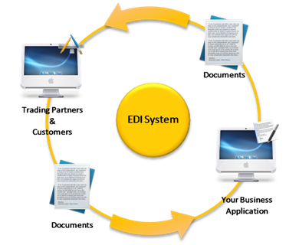
Electronic Data Interchange: Electronic Funds Transfer:
E-Commerce
EDI is the structured transmission of data between organizations by electronic means. It is used to transfer electronic documents or business data from one computer system to another computer system.
EFT is the electronic exchange or transfer of money from one account to another.

Slide 8
Advantages of E-commerce
E-Commerce
Faster buying/selling procedure, as well as easy to find products.
Buying/selling 24/7.
Low operational costs and better quality of services.
Easy to start and manage a business.
No need to set-up physical company.
Customers can easily select products from different providers without moving around physically

Slide 9
Disadvantages of E-commerce
E-Commerce
There is no guarantee of product quality.
There are many hackers who look for opportunities, and thus an e-commerce site, service, payment gateways, all are always prone to attack.

Slide 10
Types of E-commerce
E-Commerce
B2B (Business-to-Business)
B2C (Business-to-Consumer)
C2B (Consumer-to-Business)
C2C (Consumer-to-Consumer)

Slide 11
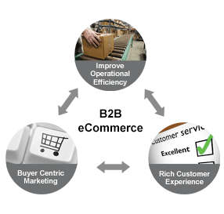
1) BUSINESS TO BUSINESS (B2B)
E-Commerce
B2B can be open to all interested parties, or limited to specific, pre-qualified participants (private electronic market).
Companies doing business with each other such as manufacturers selling to distributors and wholesalers selling to retailers.

Slide 12
2) BUSINESS TO CONSUMER (B2C)
E-Commerce
Businesses selling to the general public, typically through catalogues, utilizing shopping cart software.
B2C is the direct trade between the company and consumers.
It provides direct selling through online channels.
If you want to sell goods and services to the customer you design the supplier’s website so that anybody can purchase any products directly from it.

Slide 13
3) CONSUMER TO BUSINESS (C2B)
E-Commerce
A consumer posts his project with a set budget online and within hours companies review the consumer's requirements and bid on the project.
The consumer reviews the bids and selects the company that will complete the project.
C2B empowers consumers around the world by providing the meeting ground and platform for such transactions

Slide 14
4)CONSUMER TO CONSUMER (C2C)
E-Commerce
It facilitates the online transaction of goods or services between two people.
There is no visible intermediary involved, but the parties cannot carry out the transactions without the platform which is provided by the online market maker such as eBay.

Slide 15
The Business Opportunity in E-commerce
E-Commerce
New products and services
Electronic technologies significantly add to organizational agility and lead to new services valued by customers. In many cases, information and knowledge are becoming the new products or services of the future. Businesses are also able to source new materials, technologies or techniques and venture into markets previously outside the scope of business operations. Joint ventures are increasingly possible through e-technologies providing businesses with new opportunities and potential areas for growth.

Slide 16
The Business Opportunity in E-commerce: New products and services
E-Commerce
To access a new market, a business should consider the following 10 steps:
1. Consider the language of the country, ensuring navigation and important information is translated to suit.
2. Prepare website keywords and search engine listings to suit the language.
3. Product instructions or manuals must also be translated to suit.
4. Some products may require approval by the country’s authorities.
5. Check out VAT/GST and other tax issues.
6. Establish an after-sales and repair service reasonably close to the new market.
7. Establish a toll-free number directed to either your own business or a branch or a partnering business close by.
8. Promote the website within the new market area using the appropriate strategies, eg email, reciprocal links with local prominent website services and portals, newspapers, magazines, TV/Radio etc.
9. Specify where legal issues are to be dealt with.
10. Determine a suitable currency for exchange

Slide 17
Intellectual and human capital
E-Commerce
Email and website technologies support business, procurement, production, administration, warehousing, payment, delivery, support and feedback systems. Together, these provide whole new opportunities for a business to capture, research and leverage so much information about its customers and transactions, that exponential growth in intellectual capital is emerging as a major business benefit and addition to the balance sheet.
Systems that are “smart” and informed by business trends can improve the quality and uniformity of decision making ensuring businesses operate more effectively if staff leave or are away

Slide 18
End of Module
Thank you for your attention ☺

