Slide 1
MICRO: Enhancing Competitiveness of Micro-enterprises in Rural Areas
Module No 9: ICT Literacy for Rural Micro-enterprises
Prepared by the Consortium for the project: “Irish Rural Link – National University of Ireland Maynooth- CDI – EEO GROUP SA- IHF asbl – IDP - Internet Web Solutions SL”

Slide 2
Website creation and social networking
Overview
How many slides? | 17 slides in total
How long to read and listen? | 25 minutes (not including exploring the links provided within slides)
What is the benefit? | See aim and expected learning in following slides

Slide 3
Website creation and social networking
Unit Aim
In this unit, we will have a look at some tips for both website creation and social networking.

Slide 4
Website creation and social networking
Expected Learning Outcomes
At the end of this module you will be able to:
Identify the key element for website creation
Know what are the best strategies for social networking

Slide 5
Website creation and social networking
Website Creation
Websites are nothing more than tools and it is up to you to make them useful. The content and structure you choose for your website must take into account three extremely important criteria, namely: usability, user-friendliness and accessibility. It goes without saying that your website must reflect your brand image, and it is always interesting to use good photos and videos of your rural activities instead of stock photos.
On your website you will need to define clearly your services/products, messages and targets. Be careful because there are different types of public for any enterprise: buyers, prescriptors, institutional audiences and general public, and your website will have to address all different kind of public. Your users should not get lost.

Slide 6
Website creation and social networking
Website Creation
Before you design and programme your website, it is worth spending a little bit of time thinking about its structure, contents, menus and functionalities, but even more important ask yourself what you want to achieve with it and why, who is your potential user, and what are your key messages. Contact details (email, phone numbers, fax, address, contact person, skype contact, facebook, youtube) and menus, must be easily accessible while the user navigates and if your user have to click more than 3 times to get to the information you will lose him/her and you failed.
It is important that your website is constantly updated and lively; otherwise people will think that your rural enterprise is not really “active”. In this sense, it is useful to include a news & agenda section where you can upload news about your activities and services.
There are a lot of programs (such as Artisteer, Dreamweaver) and platforms (such as Wordpress, Wix, Sitebuilder.com) that you can use to create your own website and you can choose among different free templates available online.

Slide 7
Website creation and social networking
Website Creation
Another very important factor in website creation is positioning, here are some steps to improve your search engine positioning:
Choosing Keywords: This is perhaps the most important step of the process as incorrectly targeting phrases can result in traffic that is not interested in your product. Keyword density or frequency should be around 2-6% of total text, but natural writing is the best way to go.
Site Content: Even before starting optimizing websites get a good deal of new content, since it can be helpful for positioning purposes.
Site Structure: Create a site that is easily read and traversed by the search engines is crucial. To adequately structure your website you must "think like a search engine spider". A search engine spider reads your web page like you would read a book.

Slide 8
Website creation and social networking
Website Creation
Metatags: Metatags are located in the HTML source code of a web page that detail administrative information about a web site/page. Some information is also scanned by portals, directories, and search engines and is also listed in the web site´s description.
Add metadata to images: with the < alt > or < title > tag and include/reinforce keywords.
Optimization: Once you have your keyword targets, your content created and your site structure established you must think about the optimization of your content. The rule is: put your keywords in the content as much as you can while keeping it readable to a human visitor.

Slide 9
Website creation and social networking
Website Creation
Internal Linking: To ensure that your website gets fully indexed make sure that the spiders have an easy path through your website. Text links make the best choice as the anchor text (the actual words used to link to a specific page). Make sure you create a sitemap to all your internal pages and link to it from your homepage to increase indexing.
Human Testing: Once you have your site, it´s optimized and you have your navigation in place, the next step is to put it past someone who has never seen your site before. Ask them to find specific information and see how long it takes.

Slide 10
Website creation and social networking
Social Networking
Using social media for marketing can allow small business to grow and reach more customers. If implemented correctly, marketing with social media can bring remarkable success to your business. • Start with a clear strategy: Define your costumers, targets, products and messages. Set your goal: Selling? Informing? Get prescriptors? Get subscribers? Different channels require different approaches. You need to ask yourself What are you hoping to achieve through social media marketing? Who is your target audience? Which social media website is your target audience using? How would they use social media? What message do you want to send to your audience with the online marketing campaign?
• Planning – Building a social media marketing plan is essential. Consider keyword research and brainstorm content ideas that will interest your target audience and serve your goal.

Slide 11
Website creation and social networking
Social Networking
Follow the one- in- seven rule: The rule is: one in the seven posts can be advertising your company. The remaining six should be focused on sharing valuable content.
Provide value: While including posts that are fun, it is important that you make sure that your posts reflect your personality. It is also important that your campaigns have a content that fit your target audience.
Share news about your rural company and values: Social network marketing keeps your customers informed about, for example, your new products and about new rural styles of life that can be of interest to your community. Connect with your customers - Create a social networking profile for your business to connect directly with your customers.

Slide 12
Website creation and social networking
Social Networking
Sign up existing customers: When people visit your website or online store, request their social media accounts and email addresses to send them exclusive promotional incentives as a thank you. Include action buttons (for example, “Like this page”, “Sign up” and “learn more”) in your website.
Encourage feedback - Encouraging and acting on feedback allows you to tailor your product or service to your customers’ needs.
Links - It’s also great to link to outside articles as well. If other sources provide great, valuable information you think your target audience will enjoy, don’t be shy about linking to them. Linking to outside sources improves trust and reliability, and you may even get some links in return.

Slide 13
Website creation and social networking
Social Networking
Note what your customers want - If similar queries come up regularly, look at how they can be avoided by changing your processes. If this is not possible, add an FAQ section to your website to answer regular queries.
Watch what customers are saying about your products, campaigns and other activity: By measuring the activities of your customers, you can get a clear overview about what they think. Consistent Brand Image - Using social media for marketing enables your rural business to project your brand image across a variety of different social media platforms. Stay consistent. Measure Success by analysing data -You can’t determine the success of your social media marketing strategies without tracking data!

Slide 14
Website creation and social networking
Social Networking
Strengthen your Facebook network and build a community on Facebook. This is where your existing fans and customers meet, so you should engage differently. Ask for friendship to all those institutions and users with your same target. Make your tweets stand out. If you don't want your posts to get lost in the Twitter stream, make sure to include an image, related link or even an emoji to separate your missives from the torrent of other tweets. Boost connections on LinkedIn. Increase the contacts in your network by browsing your contacts’ connections. New contacts expose you to an even wider range of people through their friends and business partners. Create a Pinterest board or an Instagram profile. Make sure it has eye-catching visuals and present your products. Be sure to encourage your followers/customers for additional social amplification of your campaign.

Slide 15
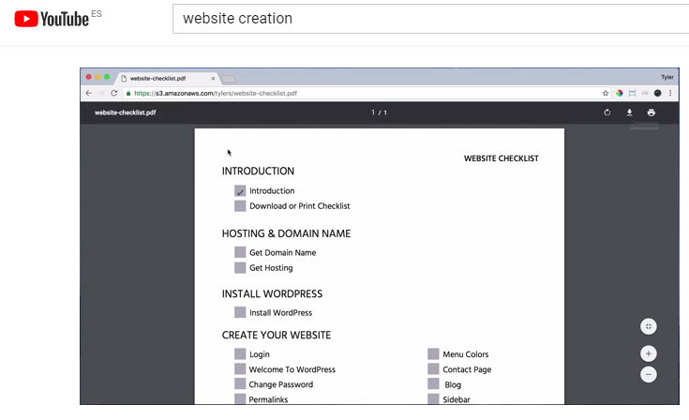
Tutorials
Website creation and social networking
How To Make a WordPress Website - 2017 - Create Almost Any Website!
By Tyler Moore
https://www.youtube.com/watch?v=xiB0HPMy4GE

Slide 16
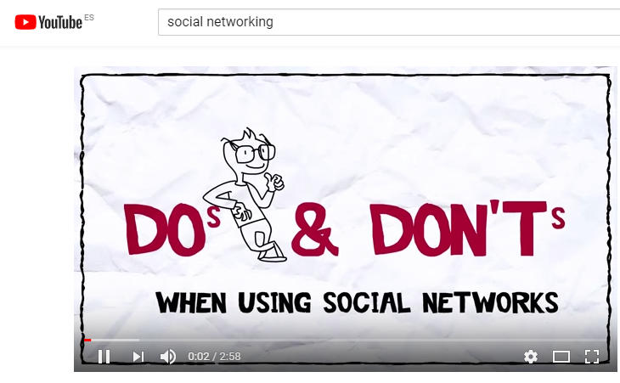
Tutorials
Website creation and social networking
Do’s and Don'ts when using social networks
By TOSHIBA leadinginnovation
https://www.youtube.com/watch?v=hqezbib5qpQ

Slide 17
End of Module
Thank you for your attention ☺

