Slide 1
MICRO: Enhancing Competitiveness of Micro-enterprises in Rural Areas
Module No 9: ICT Literacy for Rural Micro-enterprises
Prepared by the Consortium for the project: “Irish Rural Link – National University of Ireland Maynooth- CDI – EEO GROUP SA- IHF asbl – IDP - Internet Web Solutions SL”

Slide 2
Online tools for farmers
Overview
How many slides? | 17 slides in total
How long to read and listen? | 15 minutes (not including exploring the links provided within slides)
What is the benefit? | See aim and expected learning in following slides

Slide 3
Online tools for farmers
Unit Aim
This unit is an introduction to tools that are available to farmers for herd management/ grant applications etc.

Slide 4
Online tools for farmers
Expected Learning Outcomes
At the end of this module you will be able to:
Register and Log-in to Agfood.ie
Know what services are available online for farmers
Be aware of the benefits of using the online service

Slide 5
What services are available online?
Online tools for farmers
In Ireland all services are available through www.agfood.ie
Main services are:
Basic Payment Scheme
Animal Identification and Movements
Financial Self-Services
Mapping services

Slide 6
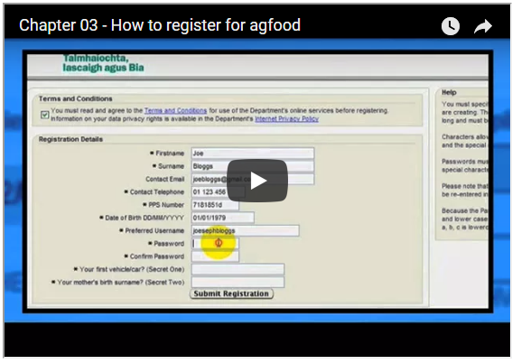
Register for the service
Online tools for farmers
This short video shows you how to register for the online services.
1 minute 16 second online Video;
Click on the picture or copy this link into your web browser -
https://youtu.be/-NvKob_zaWo

Slide 7
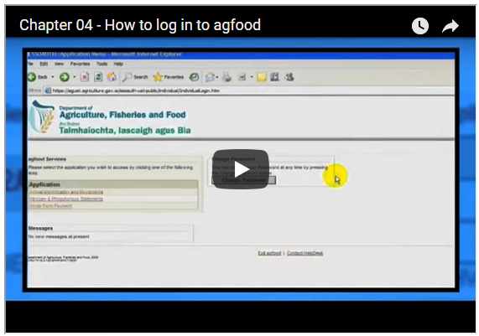
Log-in to the service
Online tools for farmers
This short video shows you how to Log-in to the online service once you are registered.
1 minute 20 second online Video;
Click on the picture or copy this link into your web browser - https://youtu.be/MIAQzf6SOjU

Slide 8
Advantages of using online services
Online tools for farmers
Available to use 24/7 365 days
Works with Farm Management Software
Partially completed forms can be saved and returned to later
Familiarity, as forms online similar to paper based forms
Completed forms can be printed for your records
Less likely for applications submitted online to be queried due to built-in checks

Slide 9
Animal Identification & Movements (AIM)
Online tools for farmers
These are the facilities available online:
Calf Birth Registration: register birth of a calf online
Cattle Herd Register: AIM online can be used as farm herd register (replace blue book)
Herd Profile Enquiry: View details of their herd and movements into and out of them
Compliance Certificate: Apply for and print online certificates
Online Movement Notification: Farmers and animal dealers can notify movements
Farm Management Software: can interact with AIM service

Slide 10
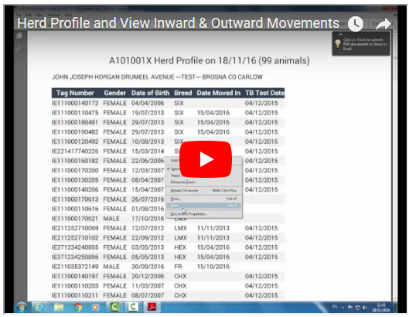
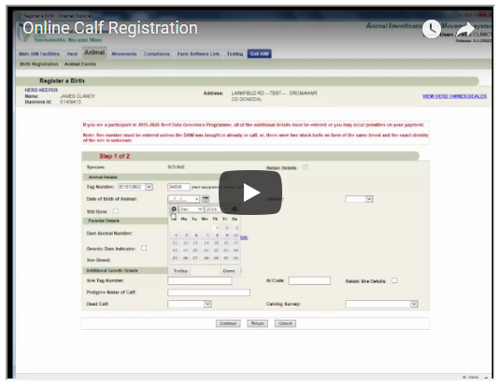
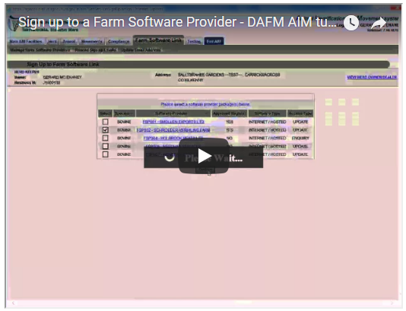
Animal Identification and Movement (AIM)
Online tools for farmers
Learn how to :
sign up to use the bovine electronic herd register
view your herd profile
view movements into and out of your herd
register calves online
what to do if you don’t receive an animal passport
apply for and print a compliance certificate and
how to sign up to and stop using a Farm Software Provider.
Tutorial videos available here

Slide 11
Basic Payment Scheme Applications
Online tools for farmers
Complete and submit online:
Your BPS application
Edit maps relating to your land parcels/plots
Your Greening requirements
Upload correspondence
A BPS Amendment application
View online:
Details of BPS Applications previously submitted
Current status of BPS application, including land details
Printable colour maps for your land parcels

Slide 12
Basic Payment Scheme (BPS)
Online tools for farmers
Also available to view:
Information relating to BPS Entitlements
Printable copies of correspondence with the Department
Details on Greening Requirements
Nitrates information
Details of Single Payment Scheme applications in 2005-2014 period

Slide 13
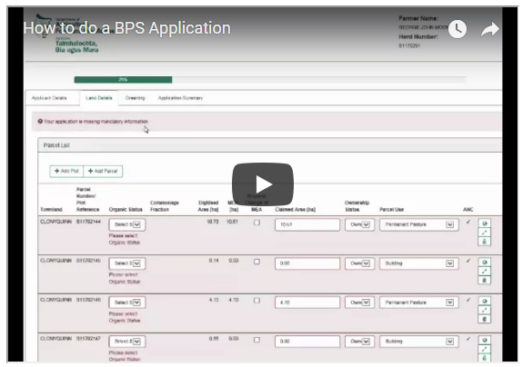
How to do a BPS Application
Online tools for farmers
This video shows you how to do a BPS Application
9 minutes 23 second online Video;
Click on the picture or copy this link into your web browser - https://youtu.be/I0N8Di5bopY

Slide 14
Financial Self-Services (FSS)
Online tools for farmers
This service allows the following activities:
View accounting data such as open invoices/overpayments and historical data
Pay invoices/overpayments electronically with Debit/Credit Card
View/Download and print Payment Remittances
View/Download and print Account Statements

Slide 15
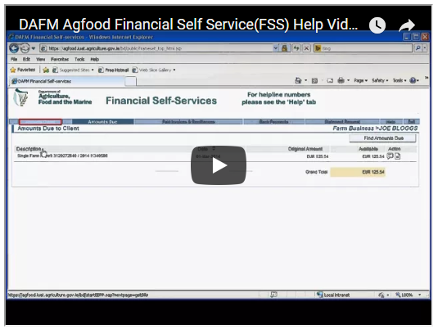
Financial Self-Services
Online tools for farmers
This video shows you how to access the FSS
3 minutes 51 second online Video;
Click on the picture or copy this link into your web browser - https://youtu.be/h4nLPuI7yow

Slide 16
Other Services Available
Online tools for farmers
Online access to annual Nitrogen and Phosphorus statements issued by the Department:
Statement of organic nitrogen and phosphorus produced by your cattle the previous year based on cattle recorded in AIM system
Nitrates Derogation Application:
Allows application form and Fertiliser Plan to be uploaded online

Slide 17
End of Module
Thank you for your attention ☺

