Slide 1
Module No 7: Pathways2market & customer identification
MICRO: Enhancing Competitiveness of Micro-enterprises in Rural Areas
Prepared by the Consortium for the project: “Irish Rural Link – National University of Ireland Maynooth- CDI – EEO GROUP SA- IHF asbl – IDP - Internet Web Solutions SL”

Slide 2
Customer identification
Overview
How many slides? | 21 slides in total
How long to read and listen? | 30 minutes (not including exploring the links provided within slides)
What is the benefit? | See aim and expected learning in following slides

Slide 3
Customer identification
Unit Aim
In this unit, we will learn how to identify potential customers to fulfil their needs and improve sales

Slide 4
Customer identification
Expected Learning Outcomes
At the end of this module you will be able to:
Identify customers to improve sales
Know how to focus on your most valuable customers

Slide 5
Customer identification
Introduction
Customer identification helps you to sell more. The more you know about them and their needs, the easier it is to identify opportunities to sell them new products and target them with appropriate offers.
Profiling existing customers also makes it easier to find new ones. You can look for similar prospects, and sell to them in a similar way.
You can use the information you have on customers to improve efficiency. Keeping a central record of customer details and sales reduces errors and speeds up transactions.
You can also improve customer service. Better access to information helps you deal with customers more quickly. You can tailor product offerings and provide personalised treatment. The right information makes it easier to identify and resolve any problems.
Finally, customer identification helps your planning. You can predict what they will buy, and estimate how much stock you need. Linking customer management to purchasing can dramatically improve profitability.

Slide 6
Customer identification
Customer profiling
The right information will let you build up a useful profile of your customers. This typically includes the following:
who they are - the age and gender of individual consumers, or industry and business size for corporate customers
what they think and believe, what are their interests and opinions
their purchasing behaviour - which products do they buy? Where do they buy them? When? And how do they pay?
Profiling your customers in this way helps you group them into different segments, each of which can be approached separately. For example, you might produce customised products or services for different segments. You can also focus the way you market to different groups of customers

Slide 7
Customer identification
Drawing a Picture
On a piece of paper, draw a person. It can be a stick figure if art isn’t your thing. Now, with your ideal customer in mind, begin to fill in details. Is this person male or female? Old or young? Write in details on the side of your drawing about income, education, where this person lives, what this person likes to do.
You may not know the answers to many of these questions. That’s the point of the exercise: to see what you don’t know about your customer. Now it’s time to fill in the gaps.
?

Slide 8
Customer identification
Analyse your customers
To understand your customers, you need to clearly identify what type of customer you are targeting, and what are their trends. Be sure to include figures and predictions for future. Who are your current customers, and why do they buy from you? Look for common characteristics and interests. Which ones bring in the most business? There are two primary aspects to any customer analysis, a demographic profile and a psychographic or behavioural analysis. Demographic profiles break down customers into age, income, geographic and other easily identifiable categories. A psychographic analysis in its simplest form identifies the reasons why customers choose to buy a certain product, their interests and buying habits.
Generally, there are three main ways to understand your customers better. One is to put yourself in their shoes and try and look at your business from their point of view. The second way is to collect and analyse secondary data to define your customers and their buying behaviour. You may be able to find information in publications, which may track demographics, sales information, trends in your industry, and other useful consumer information. The third way, suitable for already established businesses, is simply to ask your customers what they think.

Slide 9
Customer identification
Define specific demographics of your target
Figure out not only who has a need for your product or service, but also who is most likely to buy it. Think about the following factors: Age, Location, Gender, Income level, Education level, Marital or family status, Occupation, Ethnic background
Consider the psychographics of your target. Psychographics are the more personal characteristics of a person, including: Personality, Attitudes, Values, Interests/hobbies, Lifestyles, Behaviour. Those characteristics can define where you want to focus your marketing efforts. For example, if you find that the characteristics that define your customer include an interest in fine arts, you can place advertisements in local arts venues and program brochures.
Determine how your product or service will fit into your target's lifestyle. How and when will your target use the product? What features are most appealing to your target? What media does your target turn to for information? Does your target read the newspaper, search online, or attend events?

Slide 10
Customer identification
Find out where your customers hang out and their lifestyle trends
If you have a social media presence, look at the profile pages of your fans. Assess where your customers are spending their time, and then make sure that your business is visible in those places.
After you understand basic demographic and psychographic attributes of your customers, you can better target your marketing plans and be sure that your products meet the needs of your intended audience.
Analysing your customers allows you to identify those who best fit your business priorities. By conducting a market analysis, you will be able to gather valuable data that will help you get to know your customers, determine appropriate pricing, and figure out your competitors’ vulnerabilities.

Slide 11
Customer identification
Analyse your product/service with respect to customer identification
After you have identified your customers’ main characteristics write out a list of each feature of your product or service. Next to each feature, list the benefits it provides (and the benefits of those benefits). Once you have your benefits listed link them to a list of potential customers who have a need that your benefit fulfils. Tailor your products and service to meet their specific requirements. If a customer prefers delivery before noon, organise your delivery schedule to make sure that happens. The more you know about your customers, the more effectively you can market to them.
Understanding your customers lets you tailor your marketing to different segments, choosing the right media. You can ensure that each customer gets the right marketing messages, at the right time. Advertising and other promotions can be more effective if they are targeted.
You can also sell more effectively. Understanding your customers helps you see which of their needs your product can satisfy. You may, for example, be able to up-sell, explaining why a higher priced product would suit them better. You may also find opportunities to cross-sell other products that fit their profile. For example, if you know why they are buying a particular product, you can tell which other products they may also need.

Slide 12
Customer identification
Focus on your most valuable customers
Understanding who your most valuable customers are helps focus your efforts to find new customers. Often, the most effective approach is to look for similar prospects. Conduct an informal poll by asking potential customers — especially those you’ve identified as your target audience — what they’re looking for that other businesses don’t provide.
Most businesses want customers who are as profitable as possible. Customers tend to be more profitable if they: buy high-margin products; pay full price without negotiating discounts; place a small number of large orders rather than many small orders; do not cancel or amend orders; pay on time, without being chased for payment; do not require extensive after-sales service.
By analysing your records, you can assess how profitable each customer is. In some businesses, just a few customers are responsible for almost all the profits. Some of your largest customers might be among your least profitable. You may even find that there are some customers you would be better off without. Moreover, you should try to look ahead. For example, a business customer that is expanding might become more profitable for you in the future. It's important to anticipate changes and how they might affect different customers.

Slide 13
Customer identification
Listen to what your customers are saying about your business and your competitors
By knowing what they really think, you can begin to tweak your advertisements, promotions, and sales around what your customers think you should be doing, which is what you need to be doing.
You should also try to find out what they think about you and your products and services. For example, learn what they like and dislike and why they choose you. Build personal relationships with key decision-makers. If you have just a few important customers, it's worth getting detailed feedback from them.

Slide 14
Customer identification
Continually review how valuable your existing customers are
Over time, customers who used to be highly profitable might demand lower prices. Other customers may increase their turnover with you as they grow. Keep an eye on customers' future potential as well. It may be worth nurturing a relationship with a small customer with high growth potential. Working with your customers can also help you identify ways to develop new and improved products.
Build customers’ trust. Treat every buyer like they are your first. Your business’ success is dependent on the people that purchase from it, each and every one of them. This means going beyond the automatic email that is sent out when an order is placed and sending a direct Conversation message, written by me, expressing my gratitude. Not only is a timely thank-you note a great way to convey how much you value their support, but customers will often take the direct connection as an opportunity to ask last-minute questions that might be important to address before you produce or ship their order.

Slide 15
Customer identification
Customer trust
Here are some tips on how to build your customers’ trust:
Keep your shop honest. When you are focused on capturing beautiful product photos and writing snazzy copy for your item listings, it can be easy to overlook the obvious question: Will your buyers know what they will receive after looking at your listing? Your photos and item description should set clear expectations for your buyers: Do your photos showcase each item’s size and what will be included with their purchase? Do your item descriptions answer any possible questions buyers might have?
Deal with mistakes right away. Mistakes happen, no matter how hard we try to prevent them. Customer service problems can be a total nightmare, and no matter who is in the right, ask yourself, is it worth arguing with a customer? What solution would you want if the situation was reversed? Give the buyer what they’re looking for, and come up with ways to prevent the same issue from happening in the future.

Slide 16
Customer identification
Customer trust (continued)
Ask yourself, “Is there anything else I can do?” Think about what else you can you do for your buyer to ensure an exceptional experience.
Always follow up. Strategically following up with buyers after an order is processed is a must. First, you enable your buyer to alert you if they had any issues with their order so you can resolve the problem before they leave a negative review. You can also inquire about ways to improve, and proactively make changes to your shop policies and workflow to prevent similar issues from happening again. Your final correspondence is also a great opportunity to encourage buyers to leave feedback for your shop.
Finally you can enhance your credibility by adding testimonials, credentials, experiences and any background information that shows you are qualified to provide great products or services. Your aim should be to effectively convince potential customers that you are the right person to offer them what they are looking for.

Slide 17
Customer identification
Find new customers
Diversification is important. It is risky relying too heavily on just a few key customers. Even if you have many customers, it is risky if they are too similar. A change in circumstances could mean that all of them reduce their purchases at the same time.
As markets change, you should regularly review your marketing strategy. Some market segments may become less profitable as competition increases. Customers' requirements may change, for example, as individual consumers become older.

Slide 18
Customer identification
Four simple ways to "buy" new customers (1 – 2)
Advertising. The key to advertising successfully is to generate promising leads in exchange for the money you spend. To do so, it helps to offer a message that not only hits on your target customers, but also showcases the value you can offer them.
Networking and referrals Landing referrals from networking or past business associations isn't just a cheap way to pick up new business. It is also a way to pick up customers with the highest retention rates. Moreover, referral customers tend to purchase more over time and in turn become a source of additional referrals.
How do you find referrals? Beyond having a product or service demanded, you must have a clear idea of who your "perfect" or "ideal" customer is. That way, you can communicate to others in your network what type of customer you are looking for. You can also focus your own products or services to meet the needs, wants or desires of that very specific profile. Then, you need to ask for referrals from satisfied customers. Be sure to also find ways to continually thank your sources for their ongoing advocacy of your business.

Slide 19
Customer identification
Four simple ways to "buy" new customers (3 – 4)
Teaming up. Another way to leverage available resources is through what's known as a "host-beneficiary" arrangement. In this arrangement, another business with the same target customer will use their database to promote your business. They might attach a gift voucher or other discount offer for your products at the end of one of a newsletter or mailing.
Strategic Alliances. You might take that partnership a step further and form a "strategic alliance." While a host beneficiary relationship is generally a one-time or short-term commitment, strategic alliances can sometimes last for many years. As long as there is continued value to the shared audience, strategic alliances produce streams of referral business, which is ultimately what will benefit you most over time.

Slide 20
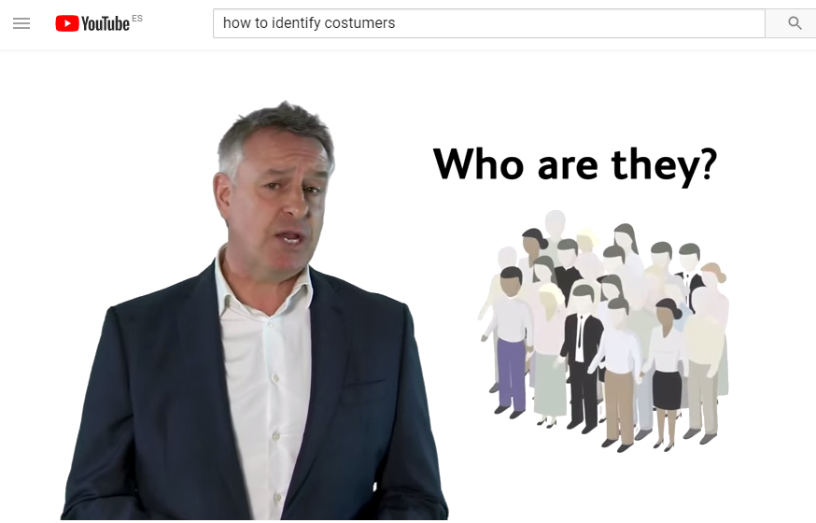
Customer identification
Identifying your customers
By Business Wales/Busnes Cymru
https://www.youtube.com/watch?v=_sbB8yVxXiQ
Here is an interesting video explaining how to identify customers

Slide 21
End of Module
Thank you for your attention ☺

