Slide 1
Introduction to UAS Technology & its Future
Partner: Dronemasters
"The European Commission support for the production of this publication does not constitute endorsement of the contents which reflects the views only of the authors, and the Commission cannot be held responsible for any use which may be made of the information contained therein."

Slide 2
Objectives & Goals
At the end of this module you will be able to:
familiarise with Unmanned Aircraft Systems (UAS)
understand current and future applications for UAS
familiarise with core UAS elements
learn about different types of payloads/sensors and their applications
familiarise with the current UAS regulations
understand the significance of Human Factors in UAS safety

Slide 3
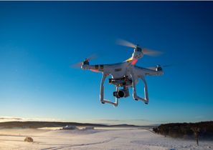
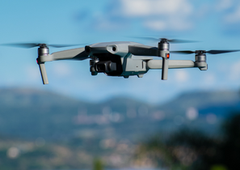
Index
Unit 1 - History
The Beginning
Need for Effective Control
Radio & Autopilot
Unit 2 - UAS Introduction and Applications
UAS Definition
Basic Technology
Payloads
UAS Software
Commercial Application
Unit 3 - The ‘System’ in UAS
Basic Elements
Platform types
Command & Control
Launch & Recovery

Slide 4
Index
Unit 4 – UAS Sensing
Introduction to sensing
Sensor Types
Geospatial Data
Unit 5 - UAS Regulations, Standards & Guidance
Aviation Regulatory System
Current UAS regulations
The Way forward
Unit 6 – Human factors in UAS
Human perception
Human Error
Situational Awareness (SA)
Summary
Test your knowledge

Slide 5
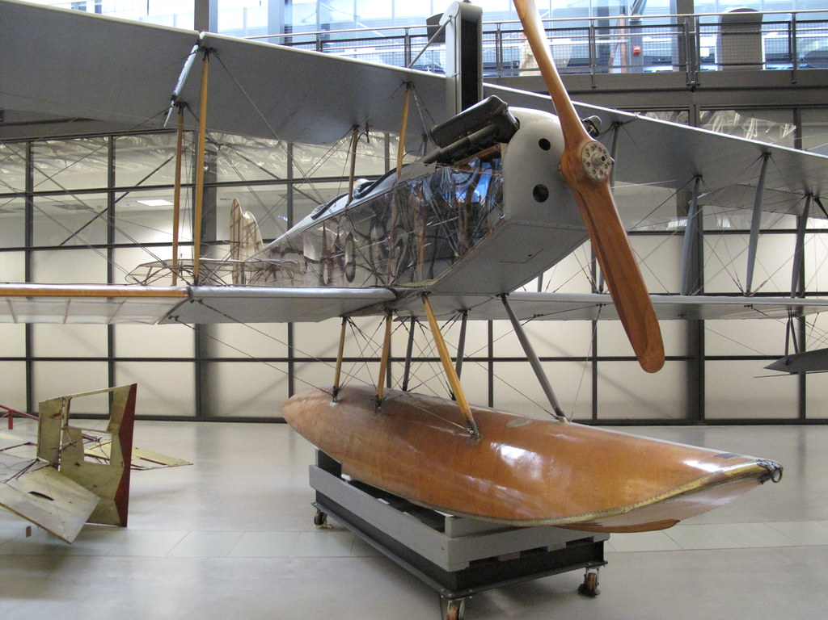
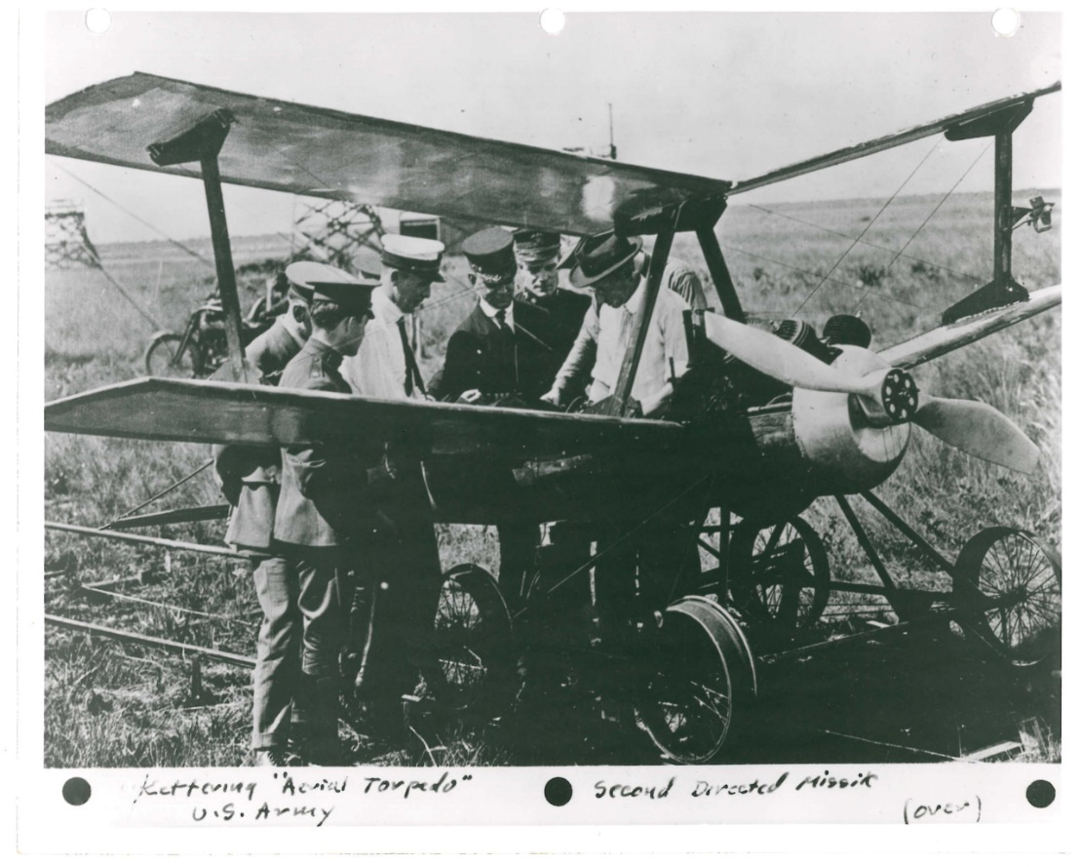
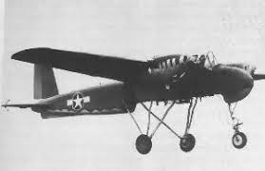
1. History
The Beginning
The first Unmanned Aircraft – Curtiss N9
First pilotless aircraft capable of carrying explosives to its target
Built by Elmer Sperry & Peter Cooper Hewitt for the US Navy during WW-I
Some of the technology in this remotely controlled plane was inspired from ‘tele-automation’, a technology used to control under-water torpedoes in 1893.
Other aircrafts that were subsequently built for the military to serve as an ‘aerial torpedo’ were the Liberty Eagle, TDN-1 ‘assault drone’
Fig. 1 Curtiss N9
Fig. 2 Liberty Eagle
Fig. 3 TDN-1 ‘Assault Drone’

Slide 6
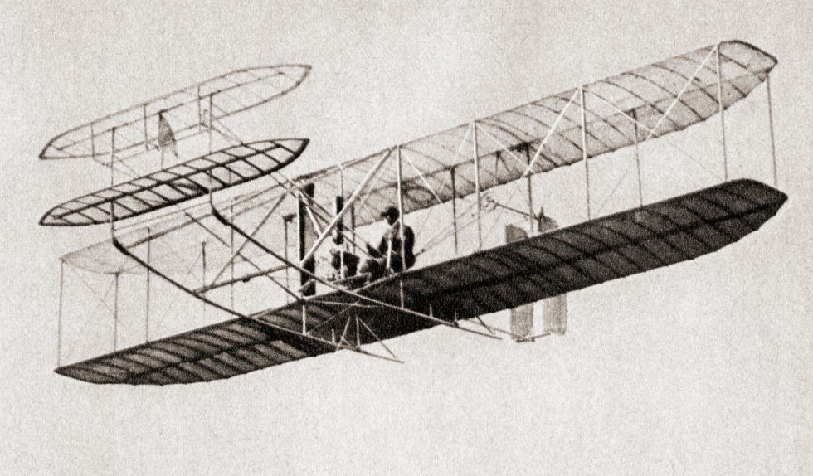
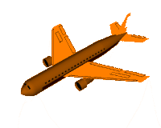
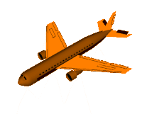
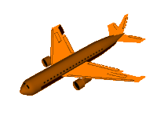
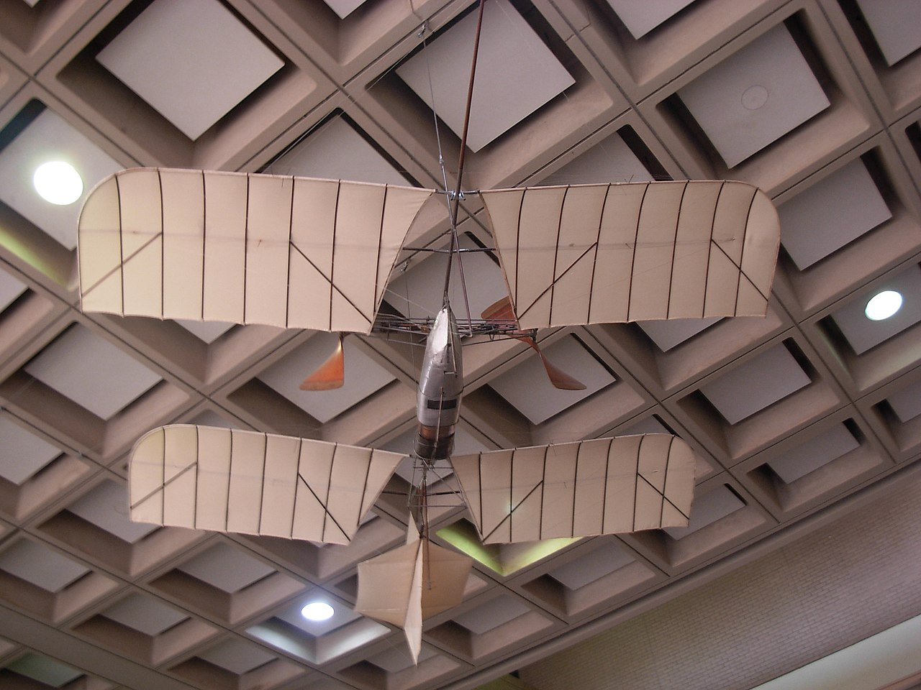
1. History
Need for Effective Control
Initial designs by the wright brothers were difficult to control.
They were attributed for developing the widely used Three-axis control (Yaw/Pitch/Roll) for heavier than air piloted.
Another famous scientist of that time, Dr. Samuel P. Langley dedicated his efforts in accomplishing stable manned flights. But failed to succeed despite receiving grants from the government and the military.
Some areas that saw significant development were optimized structures, aerodynamics, control surfaces, lifting wing configuration
Fig. 7 Wright Flyer
Fig. 4 Yaw -Axis control
Fig. 5 Pitch -Axis control
Fig. 6 Roll -Axis control
Fig. 8 Langley Aerodrome No. 6 by Dr. Langley

Slide 7
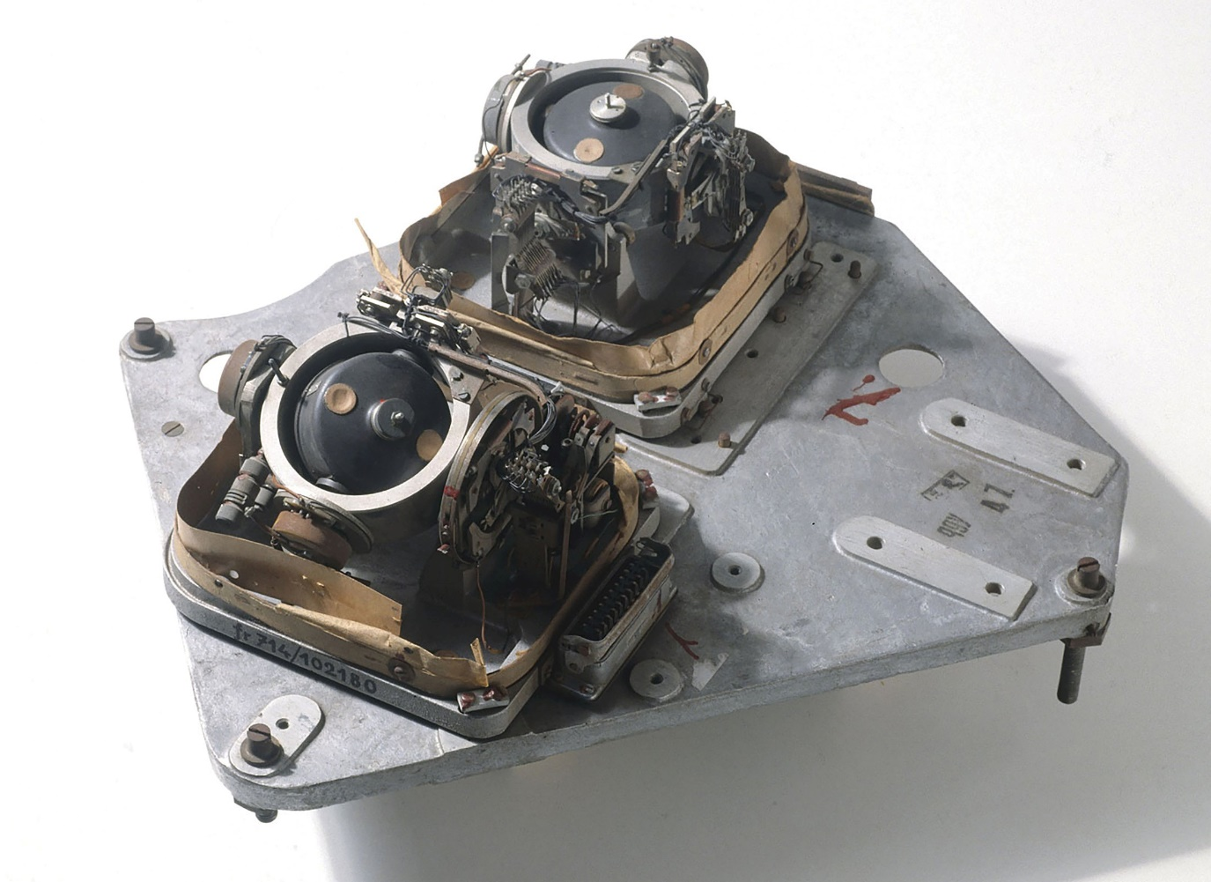
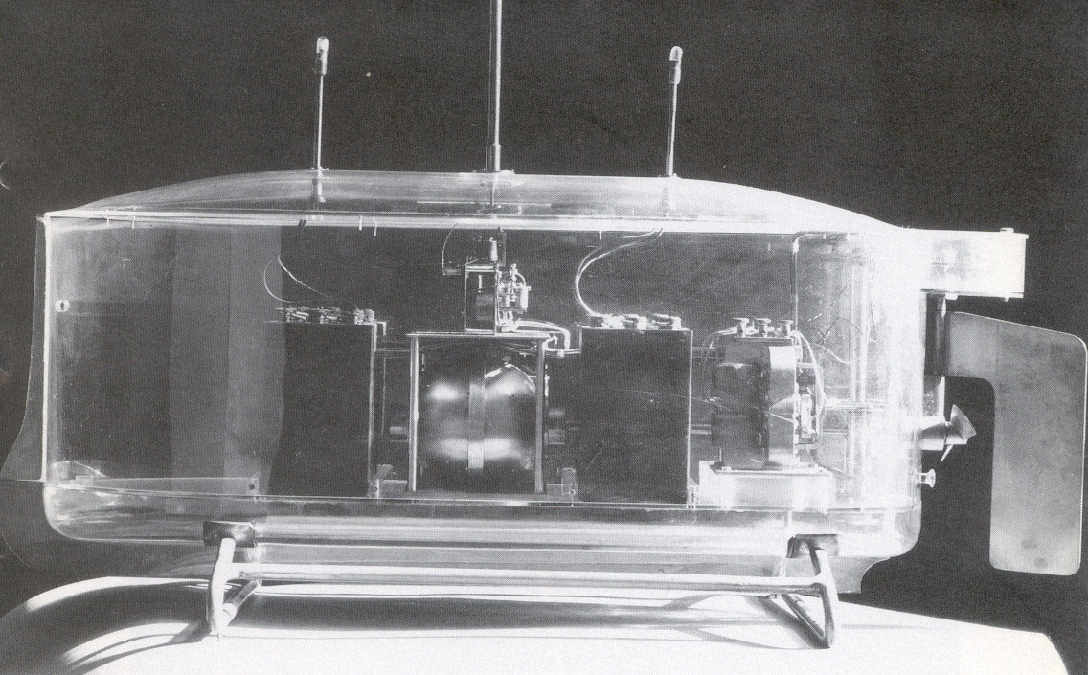
1. History
Radio & Autopilot
Several inventions contributed to the development of remotely piloted aircrafts a.k.a Unmanned aircrafts / Drones.
Prior to the invention of aircrafts, discopvery of radio waves and its use for transmitting wireless signal led to invention of what was then called as “Teleautomation”.
Underwater torpedos were invented in 1898 to guide explosives to enemy ships using teleautomation.
Another technology that was specifically designed for torpedoes was the ‘three-axis gyro’ by Elemer Sperry.
These underlying technologies allowed Sperry to perfect his design of the first reliable mechanical autopilot.
Fig. 9 Toy boat driven by Teleautomation by Nikola Tesla
Fig. 10 Three-axis mechanical gyroscope

Slide 8
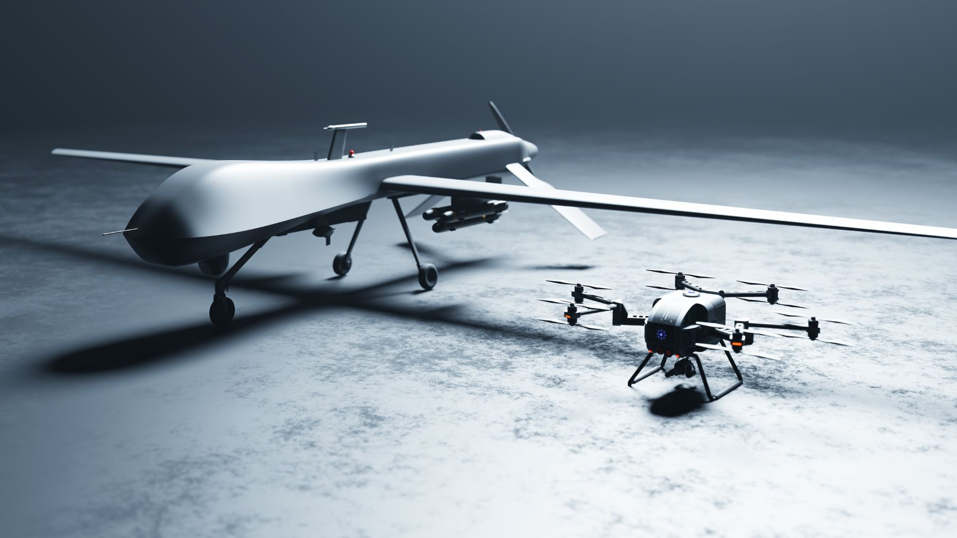
2. UAS Introduction and Applications
UAS Definition
According to Federal Aviation Administration (FAA) - An unmanned aircraft system is an unmanned aircraft and the equipment necessary for the safe and efficient operation of that aircraft.
An unmanned aircraft is a component of a UAS.
All aircrafts operated without the possibility of direct human intervention from within or on the aircraft are classified as Unmanned Aircraft Vehicle (UAV). (Public Law 112-95, Section 331(8)).
Fig. 11 Fixed wing CTOL* (Left) & multi-rotor VTOL** (Right) UAS platforms
*Conventional Take-Off & Landing
** Vertical Take-Off & Landing

Slide 9
2. UAS Introduction and Applications
Basic Technology
To understand the foundational building block of UAS one requires understanding of foundational information on vehicle control, stabilization and sensor design
Methods of control utilized in a UAS can be broadly classified into:
Manual Control – This allows a skilled UAS pilot to precisely manipulate the flight path and predictable outcome of a UAV
Stabilized Control – This allows an operator to precisely manipulate an aircrafts position through an onboard autopilot on the UAV. The level of autonomy for the UAV is higher in this case.
Automated Control – This control scenario requires the least amount of operator control. Through use of software a complete mission is planned ahead of deployment and the complete control is taken over by ground control software and onboard autopilot.
Fig. 12 Different levels of UAS Autonomy

Slide 10
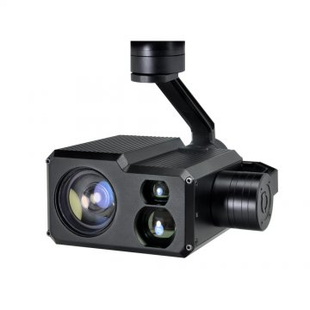
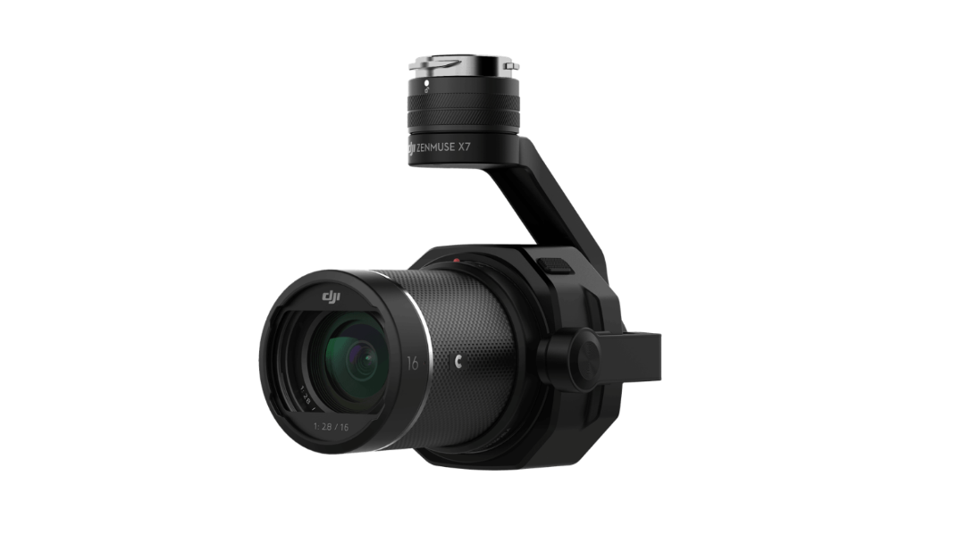
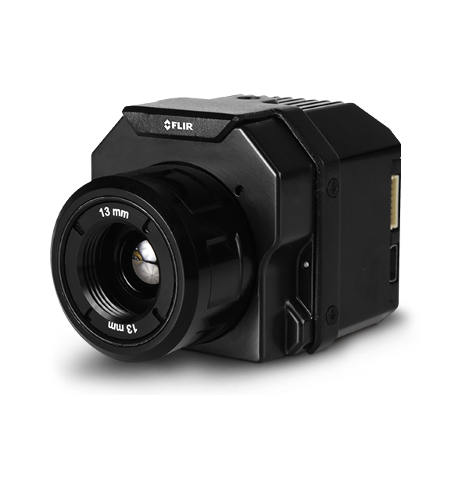
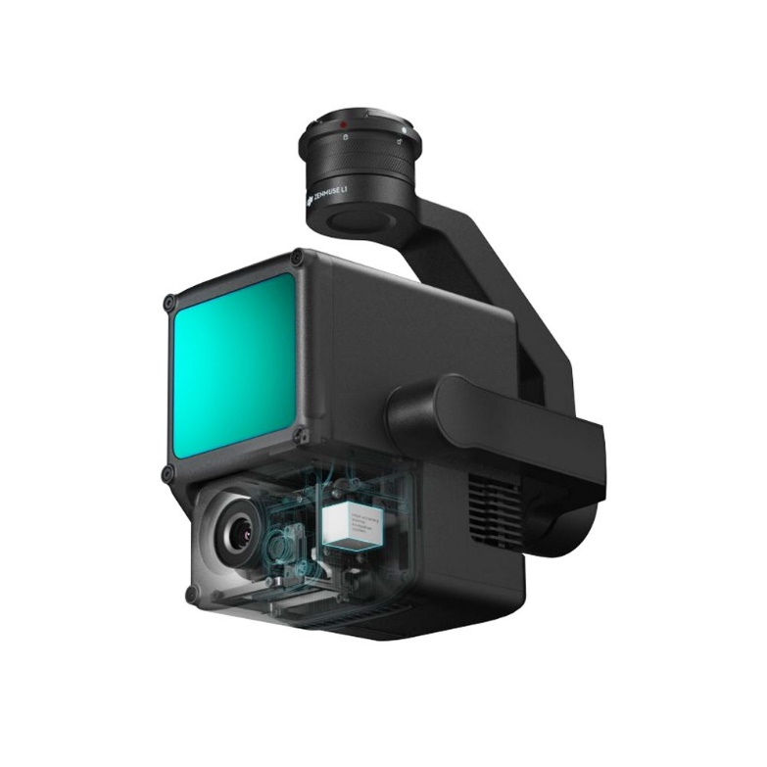
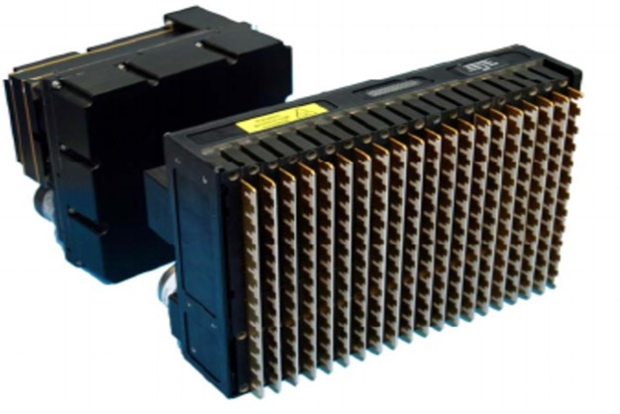
2. UAS Introduction and Applications
Payloads
Payload is defined as the total weight a UAV can carry. It does not include the weight of the platform itself.
Type of payloads can vary depending upon platforms mission objectives. Typically, they are used for data collection such as images, videos, temperature, co-ordinates etc.
Typical payloads used on UAV are:
Electro-optical Imaging Sensors
Visible RGB Sensors
IR (Infrared) Sensors
LiDAR (Light Detection & Ranging) Sensors
SAR (Synthetic Aperture Radar)
Fig. 13 Electro-optical Imaging Sensor
Fig. 14 Visible RGB Sensor
Fig. 15 IR Sensor
Fig. 16 LiDAR Sensor
Fig. 17 SAR Sensor

Slide 11
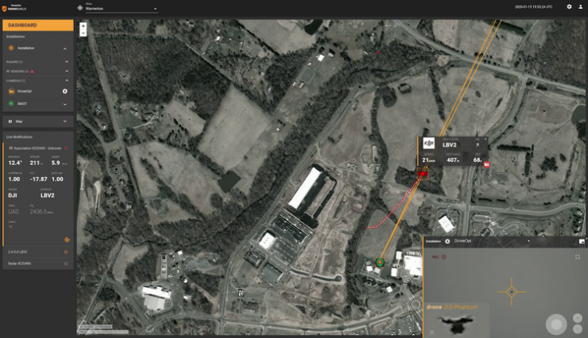
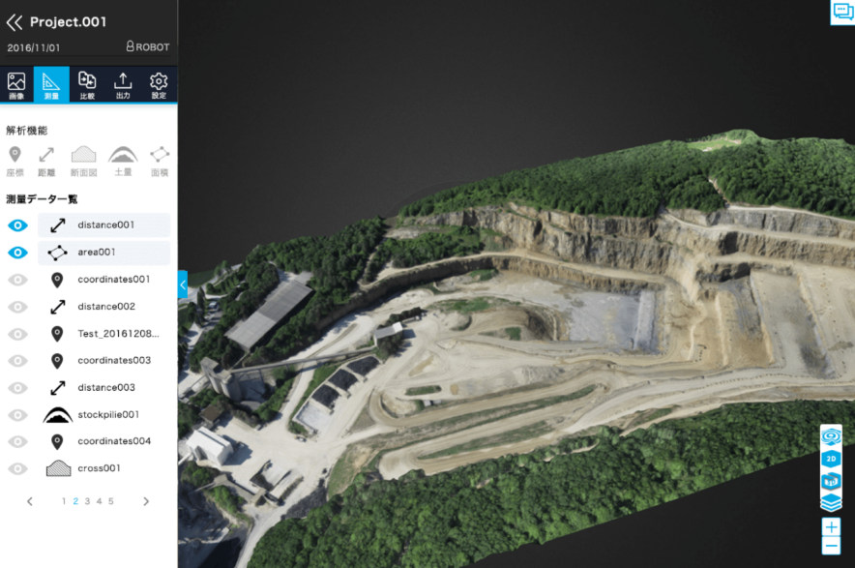
2. UAS Introduction and Applications
UAS Software
Software is a key components of any UAS system irrespective level of autonomy the UAV has.
Onboard autopilot, ground-based data processing and many other functions today are fulfilled by software.
Typical softwares that are today commercially available are:
UAS fleet management software
Autopilot software
Sensor Data asset management
Analytical photogrammetry software
Change detection and machine learning
Computer vision software
Autonomous flight path planning software
Fig. 18 UAV flight path planning User Interface
Fig. 19 3D data rendering application

Slide 12
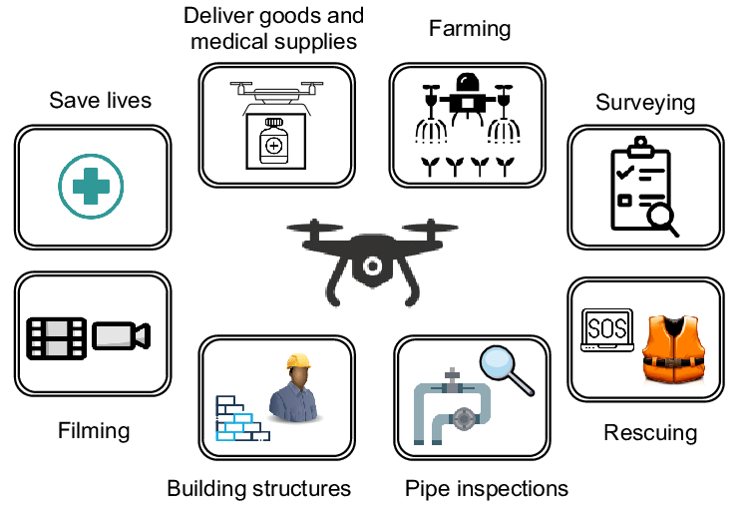
2. UAS Introduction and Applications
Commercial Application
Today drones/UAVs are used in a wide variety of commercial applications from recreational to agriculture and city planning.
The rapid boom in its widespread adaption can be attributed to the low cost and availability of UAS hardware and software as Commercially Available Off-the Shelf (COTS) components.
In addition to that open-source development projects such as Dronecode that led to development of PX4, MAVLink etc. gave people the opportunity to build bespoke systems.
Typical commercial applications that are very common these days are:
Building Inspection
Aircraft Inspection
Oil, Gas, Power lines, Powerplant inspection
Public infrastructure (bridges, dams, roads etc.) inspection
Aerial mapping/surveying
Precision agriculture
Filmmaking
Marketing and light shows
News reporting
Meteorology
Cargo delivery
Fig. 20 UAS commercial Use-Cases

Slide 13
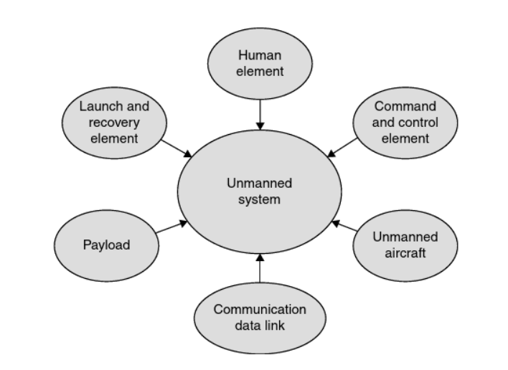
3. The ‘System’ in UAS
Basic Elements
A UAS comprises of a group of interacting or interrelated elements that act in coordination to realize the objectives/mission of a user/operator/customer.
Most UAS consist of a:
UAV/Remotely piloted platform
Human pilot
Payload
Control elements
Data link communication element
Launch and recovery element (In some specialized systems)
Fig. 21 Basic Elements of UAS

Slide 14
3. The ‘System’ in UAS
Platform Types
UAVs a.k.a Remotely Piloted Vehicles (RPV) are broadly classified in different categories based on their weight and performance class.
The regulation on weight class and performance can vary from country to country. But in general, they are differentiated as small UAS (sUAS) which are less than 55lbs or larger UAS which are 55lbs or more.
UAS platforms are also classified based on their flight characteristics. Such as:
Fixed Wing (Conventional Take-Off & Landing CTOL)
Vertical Take-Off & Landing (VTOL)
Hybrid platforms (capable of both CTOL and VTOL)
Fig. 22 UAS classification (US Department of Defense - DOD)

Slide 15
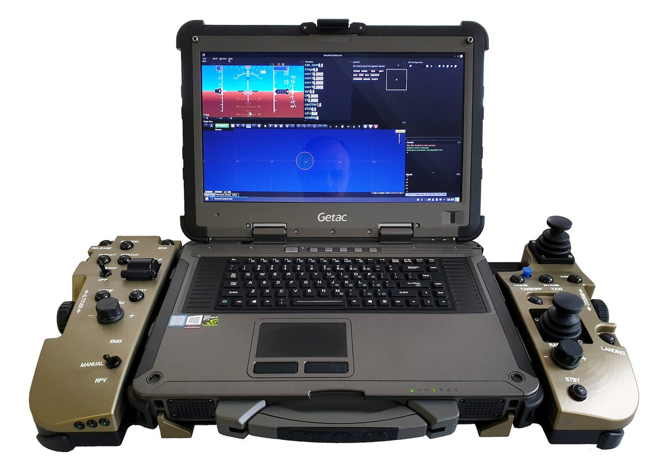
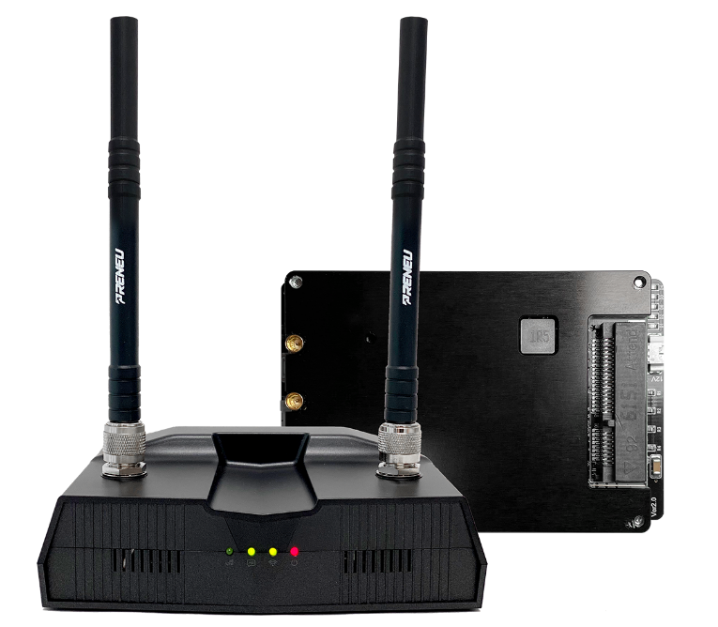
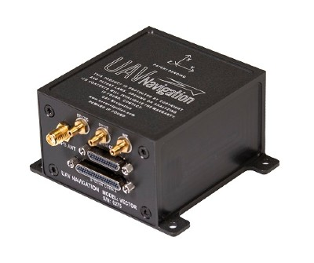
3. The ‘System’ in UAS
Command & Control
The concept behind UAS is to leverage the ability of these systems to execute missions following a set of pre-programmed instructions with limited/without human intervention.
Autopilots allow platforms to execute those instructions while maintaining a stable flight.
Ground Control Station (GCS) on the other hand provides the Human-Machine Interface to provide instructions to UAV.
Wireless Data link is what enables GCS to relay command and control instructions to the autopilot of the UAV. It also comprises of bandwidths allocated to payload data transmission.
UAS operations can be broadly classified into:
Line Of Sight (LOS)
Beyond Line of Sight (BLOS)
Beyond Visual Line of Sight (BVLOS)
Fig. 23 GCS
Fig. 24 Data Link hardware
Fig. 25 UAV Autopilot

Slide 16
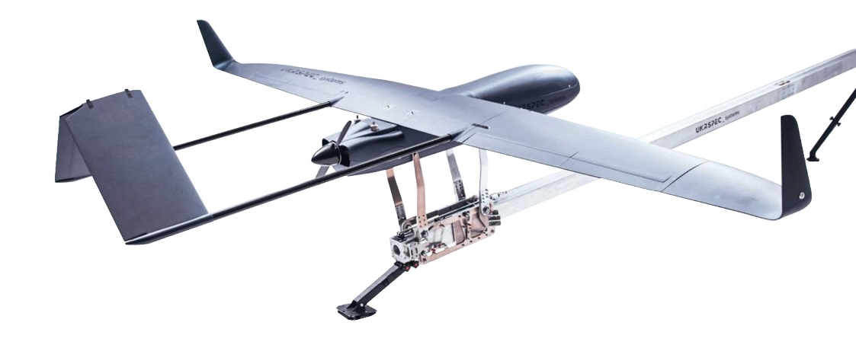
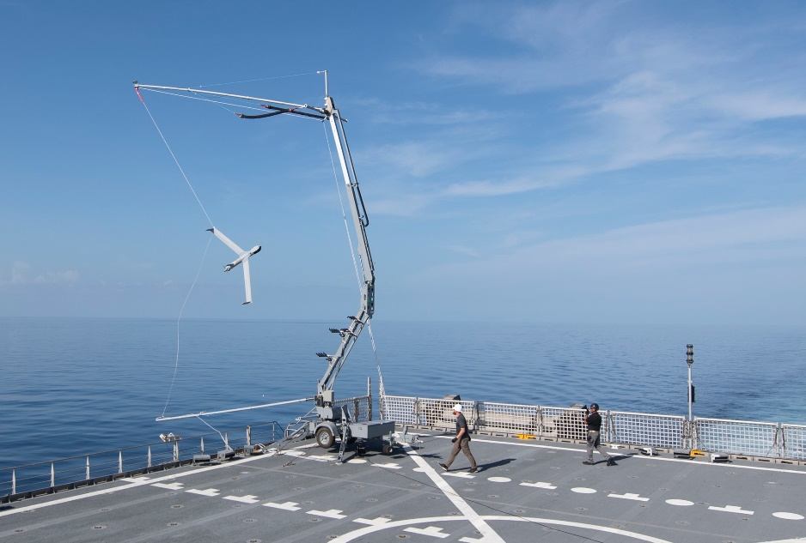
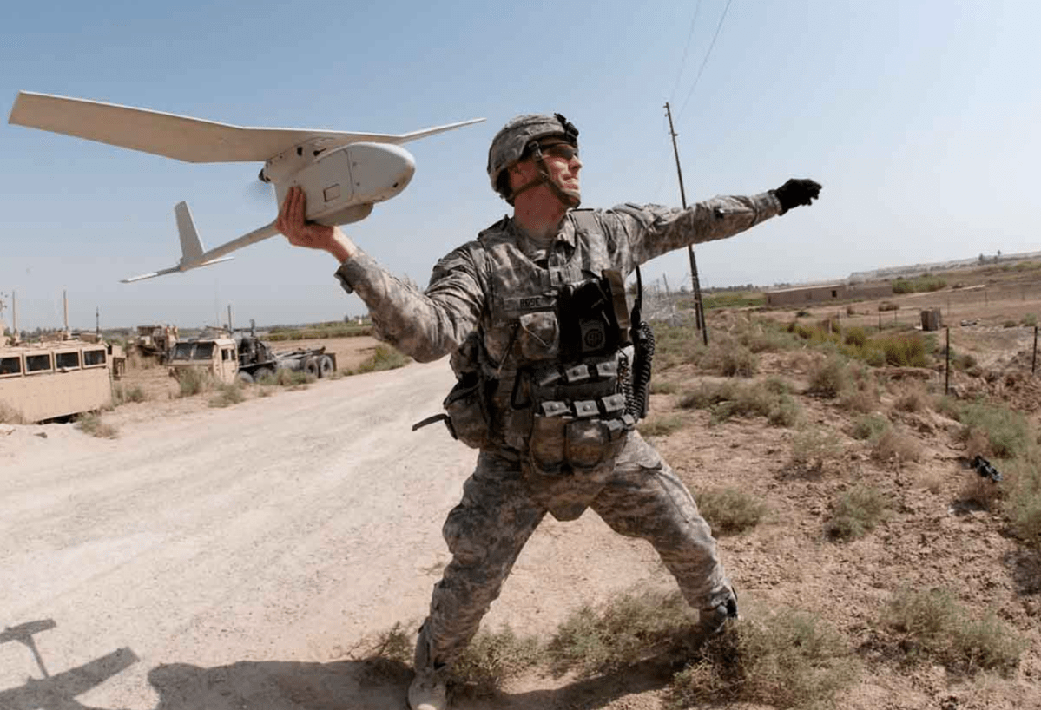
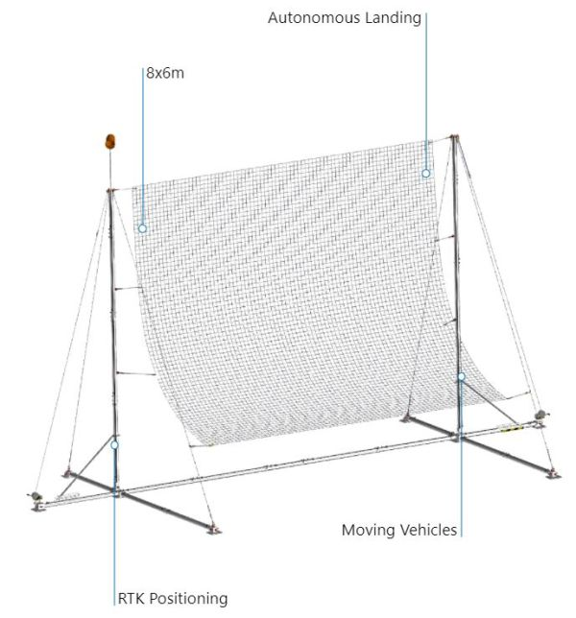
3. The ‘System’ in UAS
Launch & Recovery
Launch & Recovery (L&R) element is one of the most labor-intensive aspects of the UAS.
Most sUAS do not require and L&R equipment.
For larger systems, a L&R element can vary widely vary based on platform type, architectural design, operational environment & requirements etc.
Some typical launch systems widely used are:
Catapult Launch
Hand Launch
Parachute recovery
Net recovery
Hook Recovery
Fig. 26 Pneumatic catapult launch system
Fig. 28 Hook Recovery
Fig. 29 Hand Lauch
Fig. 27 Parachute Recovery
Fig. 30 Net Recovery

Slide 17
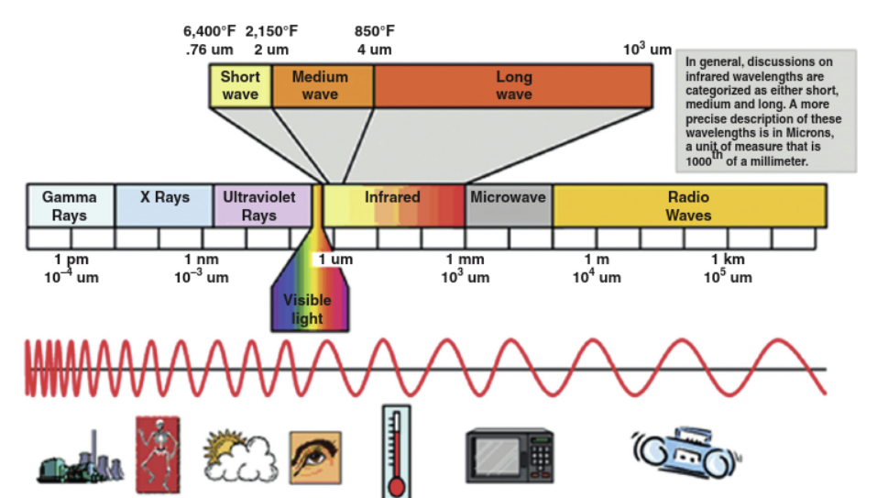
4. UAS Sensing
Introduction to Sensing
Sensor payloads onboard UAVs sense the environment in which they operate through Active & Passive Sensing.
Active sensors emit electro-magnetic energy towards external objects to capture and analyze the reflected energy. Examples of Active sensors are:
LiDAR
SAR
RADAR
Passive sensors such as visual cameras, only capture energy emitted by external sources. Some example of Passive Sensors are:
RGB Camera
IR Sensor
Fig. 31 Electromagnetic energy spectrum

Slide 18
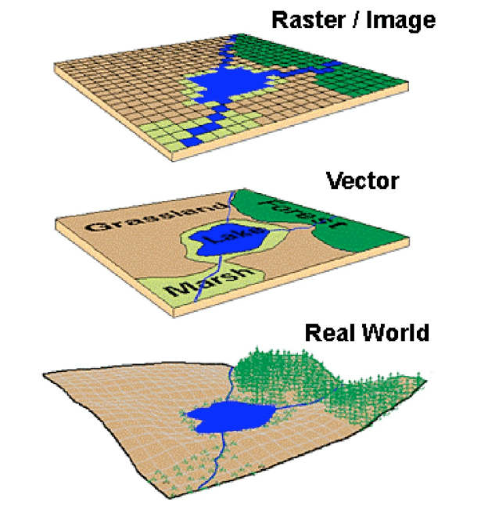
4. UAS Sensing
Geospatial Data
UAS is often used to study spatial information of the subjects or the environment. UAS sometimes uses this information for navigation, path planning and localization.
This approach is also known as Simultaneous localization and mapping (SLAM) which is a computational problem of constructing or updating a map of an unknown environment while simultaneously keeping track of a UAV’s location within it.
SLAM approach utilizes geospatial data which is available as:
Raster data – data stored as values in a contiguous grid
Vector Data – data stored as points, lines, polygons etc.
Fig. 32 Representation of Raster and vector data

Slide 19
5. UAS Regulations, Standards & Guidance
Aviation Regulatory System
FAA and European Aviation Safety Agency (EASA) regulate the usage of national airspace within USA and Europe Union (EU).
They are responsible for ensuring safety and environmental protection in air transport in Europe and USA.
Original Equipment Manufacturers (OEMs) and operators typically drive and motivate regulations in any technical environment such as aviation.
On September 16, 2005, the FAA released memorandum AFS-400 UAS Policy 05-01 as a guideline to the usage of UAS in the U.S. National Airspace System (NAS).
EU Regulations 2019/947 and 2019/945 set out the framework for the safe operation of civil drones in the European skies.

Slide 20
5. UAS Regulations, Standards & Guidance
Current UAS regulations
In USA current drone regulation require any drone to be:
Less than 55lbs
Operate within Visual Line-Of-Sight (VLOS) of the pilot in command/visual observer
Not operate directly over people
Operate in daytime only
Fly at speed no greater than 100 mph (87Knts)
Fly below 500 feet (AGL)
Not operate in class-A airspace
Operate in class-E airspace only after approval from ATC
Operate in minimum weather visibility of 3 miles
Shall be only operated by a licensed pilot under Part – 107
In EU current drone regulation require that (National regulations can defer for each country):
You must obtain an EU Drone Certificate before flying a drone weighing 250 grams or more
You must register as a drone pilot and attach an operator number to your drone.
The drone must fly at a maximum height of 120 meters
The drone must be flown within the direct view of the pilots
The drone may only be flown during the day in the Netherlands
You are not allowed to fly in a (temporary) no-fly zone
You are not allowed to fly above uninvolved persons
Fig. 33 Licensed UAS Pilot

Slide 21
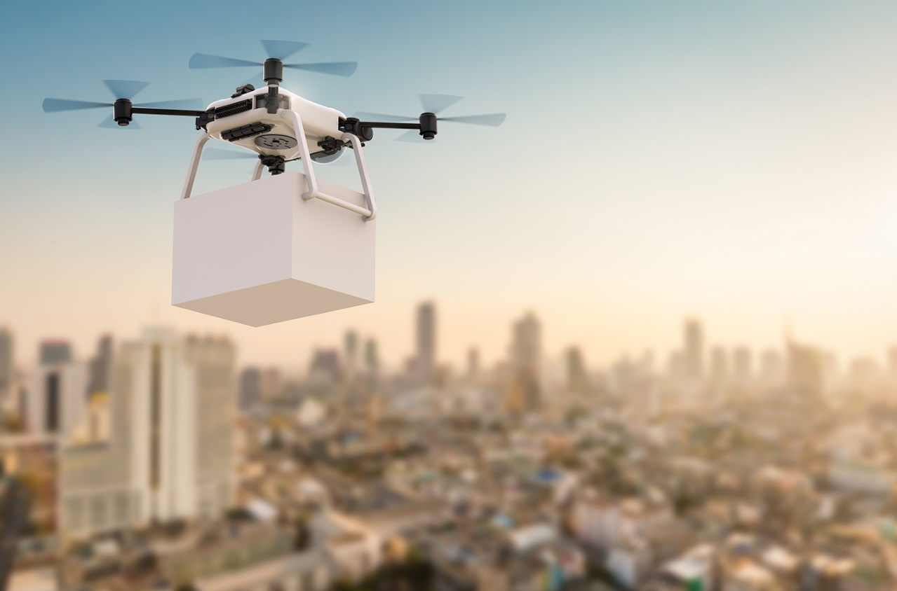
5. UAS Regulations, Standards & Guidance
The Way Forward
The aviation environment is a complex, dynamic, and full of pitfalls because of the numerous stakeholders (designers, operators, users etc.) involved in the process of seeking access to NAS.
Hence it requires more caution when introducing new regulations such that the rules of engagement are fully understood.
Active involvement of Industry partners and operators is very important for allowing an organic growth of this industry.
The biggest challenge for the regulatory bodies such as the FAA and EASA is to arrive at coherent, rational and enforceable policies, procedures, rules and regulations for the UAS industry.
Fig. 34 Drone cargo delivery

Slide 22
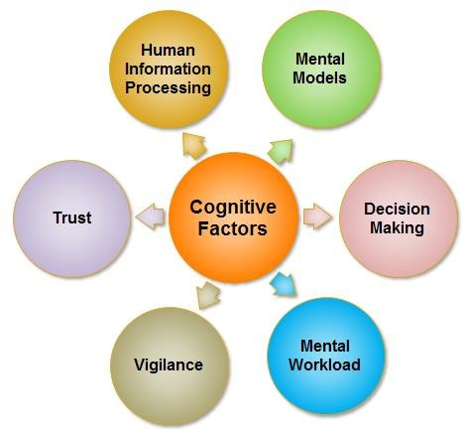
6. Human factors in UAS
Human perception
The human element in UAS operation is very critical to the overall safety and success of UAS industry.
The overall goal of human factors in UAS is to provide users, customers and operators with the necessary guidance, knowledge and skills to archive a safe operation of UAVs.
Though humans are highly adaptive to their environment (which makes them the most intelligent species on this planet), they do experience mental/physical fatigue, disorientation, miscommunication etc. which often leads to hazardous and catastrophic situations due to human error.
Some of the many reasons that can be attributed to these can be classified into:
Perception Errors
Selective attention
Lack of focused attention
Divided attention
Fig. 35 Factors influencing human cognition

Slide 23
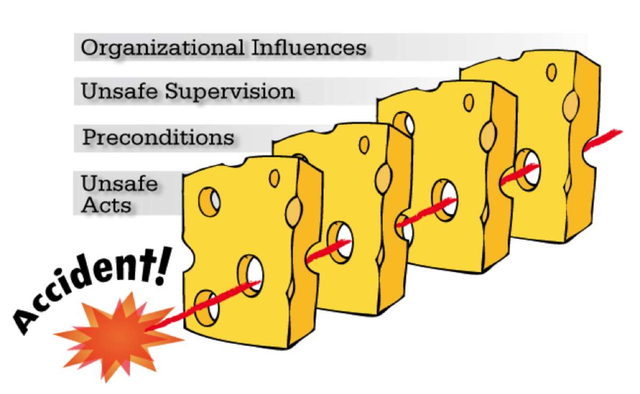
6. Human factors in UAS
Human Error
According to Senders & Moray (1991)* and Error is defined as “not intended by the actor, not desired by a set of rules or an external observer, or that led the task or system outside its acceptable limits.
Safety critical industry such as the aviation industry employs strategies to detect and prevent human errors before they occur.
In human factors the swiss-cheese model is often used to describe how errors slip through the guards of different layers of supervision and combining with certain preconditions that eventually leads to accidents.
There are essentially four layers of influences that lead to accidents:
Organizational influence – lack of policies, guidance, rules etc.
Supervisory influence – lack of supervision from individuals
Pre-conditions – conditions facilitating the cause of accident
Operator actions – actions taken by the operator leading to the event
*Senders, J.W., & Moray, N.P. (1991). Human Error: Cause, Prediction, and Reduction (1st ed.). CRC Press. https://doi.org/10.1201/9781003070375
Fig. 36 Swiss-Cheese model of human error

Slide 24
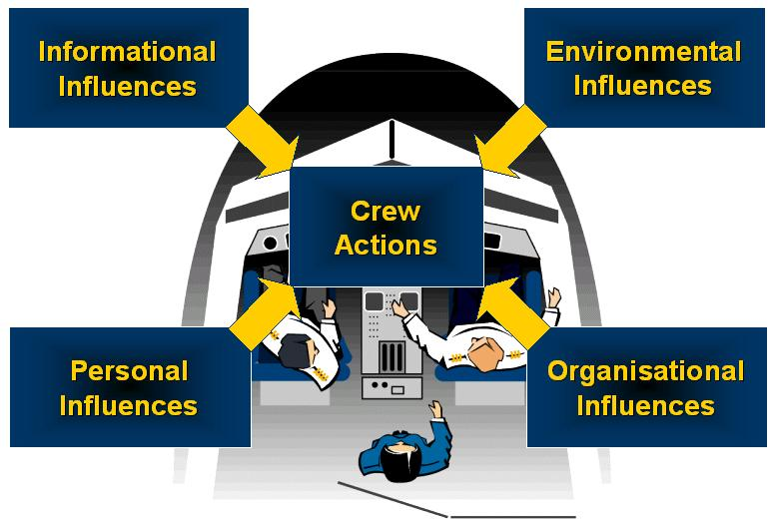
6. Human factors in UAS
Situational Awareness (SA)
Marinating situational awareness is the key to a safe and efficient UAS industry.
It is defined as an “internalized mental model of the current state of the flight environment”
There are four aspects of situation awareness, seen as a common steps in decision making process:
Vigilance – managing the right type of attention
Diagnosis – identifying the root cause of the situation
Risk analysis – understanding the impact of the situation
Action – taking right actions to mitigate risk
Other ways to improve SA is through design.
Efficient design of Human-machine interface (HMI) can make critical information more accessible, reduce pilot work-load and alert actors way ahead of time.
Fig. 37 Factors influencing SA

Slide 25
Summing up
New use cases identified by military in the early 20th century and new technologies coming together led to the development of UAS in the initial days.
UAV can have different levels of autonomy based on the technology and control method used.
UAVs carry a wide range of payloads suitable for all kinds of mission/objective.
Software is a critical component of UAS that enable pilots to navigate, control and process data.
Based on the weight and performance of UAVs, regulatory bodies classify UAVs to govern the rules of operation and ensure safety of people and environment.
For the UAS industry to grow and prosper, safety shall be the primary objective of designers, operators, maintainers and pilots.
Human factors play a vital role in this. Hence, we should aim to minimize human error and avoid any potential cause of accidents.

Slide 26
Thank you!

